Slide 1


Linlithgow Academy Family Session

Slide 2
National 5
English
Course Overview
The National 5 course is made up of 4 components
Folio – 30%
RUAE (paper 1) - 30%
Scottish set text (paper 2) - 20%
Critical essay (paper 2) - 20%
Every mark is worth a percentage!
A – 70% and over
B – 60% - 69%
C – 50 % - 59%
D – 40% - 49%
NA – 39% and below
NB – this is a guide, some years they may change the boundaries

Slide 3
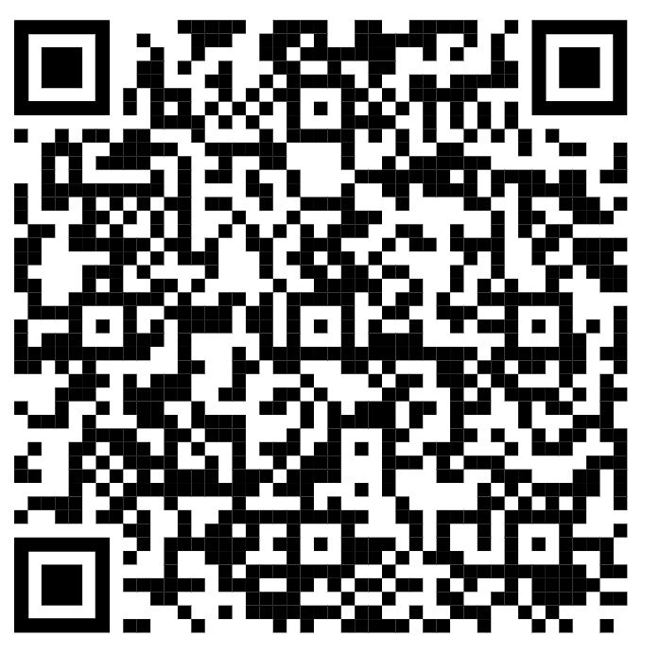

National 5
English

Slide 4
National 5
English
What is RUAE?
RUAE stands for reading, understanding, analysis and evaluation.
RUAE makes up the entirety of paper one – it is 60 minutes long and is worth 30% of the final grade.
In this section of the exam there will be an unseen non-fiction pieces of writing – the topics of the extract vary but the topic is mostly irrelevant.
There are different question types, but there are different formulas to help answer each question.
This is nationally the paper that Scottish students find most challenging.

Slide 5
NATIONAL 5
English
What do they need to know and how can I help?
What they need to know | Suggested home support
The formulas | Memorising the structures from the formula sheet.
Understanding questions (own words) | Synonym drills (give the pupil a word and see how many alternatives they can come up with). Read news paper articles and summarise into 5 key points.
Understanding questions (context) | Print newspaper articles, pupil underlines any words they don't know, tries to work it out from surrounding words.
Analysis (sentence structures) | Learn different sentence types and what they are commonly used for.
How to answer questions | Past papers and timed practice
Good vocabulary | READ READ READ

Slide 6
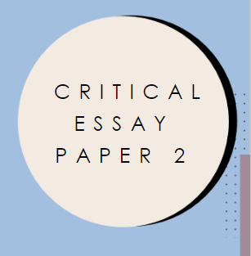
NATIONAL 5
English
Scottish Set Text-
Paper 2

Slide 7
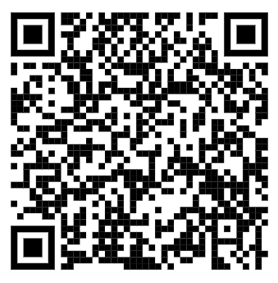

National 5
English
Note: 2026 update
As of 2026 QS have updated the list of poems on the exam curriculum meaning that some Duffy poems on old exam papers are no longer used.
Poems taken out: War Photographer, Valentine, The Way My Mother Speaks
Poems kept in: Mrs Midas, Originally, Mrs Tilscher's Class
Poems added: Havisham, Before You Were Mine, Medusa
2

Slide 8
National 5
ENGLISH
What is Scottish set text?
Scottish Set Text is a selection of poetry, plays and prose by Scottish authors selected by QS.
SST makes up the first half of paper two – it is 45 minutes long and is worth 20% of the final grade.
In this section of the exam there will be either a poem that the pupils have studied from Carol Ann Duffy OR an extract from Sailmaker by Alan Spence.
The first 12 marks will ask questions on the text in front of you whereas the last 8 marks will ask you to compare the poem to another poem by Duffy/ extract from the play.
The first 12 marks will be shorter questions which follow the 'quote + explain' structure, whereas the last 8 marks follow a specific 8 mark structure.

Slide 9
NATIONAL 5
English
What do they need to know and how can I help?
What they need to know | Suggested home support
Quotes | Test learner 'can you write down 5 quotes from... about...'
Detailed annotation and analysis | Question learner using their annotations - *read quote* - can you tell me about this?
Detailed knowledge and understanding of the texts | Can you tell me 5 facts about *inset character*?
8 markers | Practice past 8 markers from the SQA past questions
How to answer 8 marker | Learn the structure

Slide 10
NATIONAL 5
English

Slide 11
NATIONAL 5
English
What is critical essay?
The critical essay section asks the pupils to write an essay on the text they have studied. Critical essay makes up the second half of paper two – it is 45 minutes long and is worth 20% of the final grade.
In this section of the exam there will be a list of exam questions split into categories (prose, drama, poetry etc) in each section there is a choice of two exam questions.
The pupil will only answer one question from the section they have been studying.
The pupil will then write a critical essay (introduction, 4 PEEL paragraphs and a conclusion) answering the question and discussing techniques such as language devices, themes, characterisation etc.

Slide 12
NATIONAL 5
English
What do they need to know and how can I help?
What they need to know | Suggested home support
How to write an introduction | Practice writing timed introductions (TARTS)
Detailed annotation and analysis (PEEL paragraphs) | *read quote* - can you tell me about this? Practice timed PEELs
Detailed knowledge and understanding of the texts (plot, setting, character, theme) | Can you tell me 5 facts about *inset theme*? Can you tell me 5 ways the theme is explored?
How to write essays with a time constraint | Practice past essay questions from the SQA, time yourself.
How to answer questions | Create different essay plans
Quotes | Test learner 'can you write down 5 quotes from... about...'

Slide 13
NATIONAL 5
English
Before we look at coursework, here are some key assessment dates for the diary:
Time-scale | Assessment/ KEY DATE 2026-2027
During October | Folio write-up
W/C 23rd Nov | English formal assessment (RUAE and TA only)-
After prelims (Exact date TBC) | Marked folios returned to pupils for revision
Tuesday 26th January | Critical Essay formal Assessment
W/C 22nd February | Textual Analysis Class Assessment
W/C 1st March | RUAE Class Assessment
W/C 8th March | Critical Essay Class Assessment

Slide 14
NATIONAL 5
English
Folio

Slide 15
NATIONAL 5
English
What is folio?
Folio is comprised of one piece of writing (either broadly creative OR broadly discursive).
At Linlithgow Academy we look at creative as being either a short story or a reflective piece, whereas, discursive is a persuasive essay.
Word count should be 1,000 words long (you're allowed 10%, so 1100) and is marked out of 15.
The mark is then doubled to give a total out of 30.
The first draft of the folio is written in class under exam conditions.

Slide 16
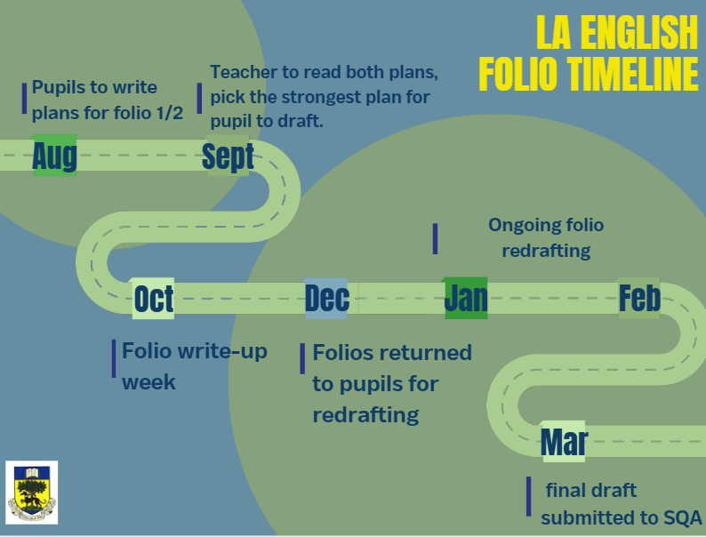

Slide 17
NATIONAL 5
English
How can I best support my learner?
Whilst it is important to note that according to QS guidelines –
"The portfolio–writing is a final summative assessment and when a candidate begins the process of drafting their pieces of writing this should be under the direct supervision of their teacher. At this point, no other person can be involved in the discussion or review of the candidate’s work."
You are able to support by checking their work and suggesting areas they may want to double-check.
There are feedback checklists for persuasive and reflective folio, along with all the information from these slides, in a parental booklet that your child's teacher will add to their respective MS Team.

Slide 18
Feedback
How will I/my learner know how they are doing and how to improve?
Here in the English department, your child will receive feedback in some of the following ways:
Live marking
DIRT Codes
Learning Conversations
Tracking Booklets/Reflection Booklets

Slide 19

Support materials

