Slide 1

Computing Science
Study Skills

Slide 2
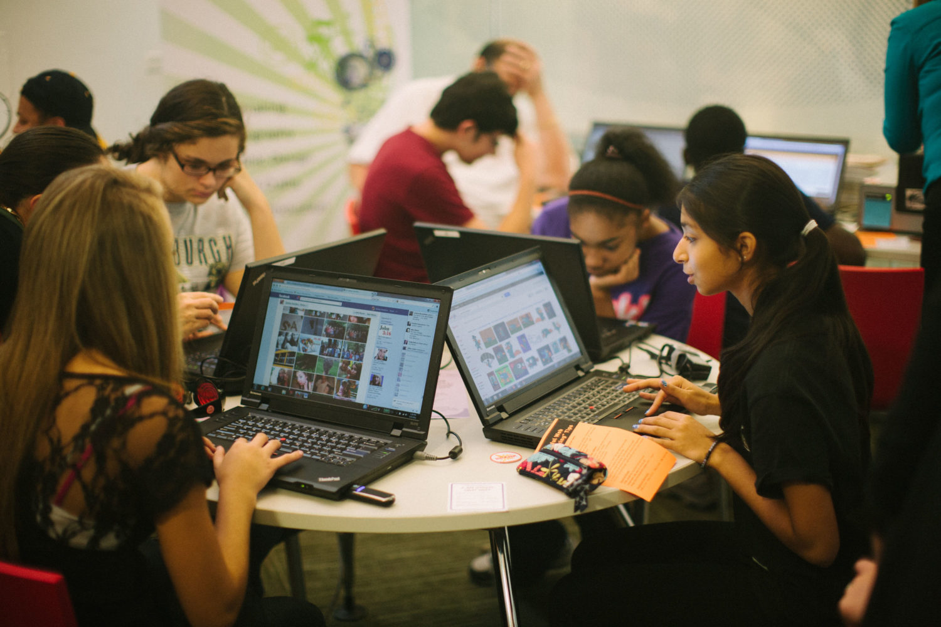
Welcome to the Computing Science Department
  Miss Blair
  Mr Williamson
  Ms Campbell

Slide 3
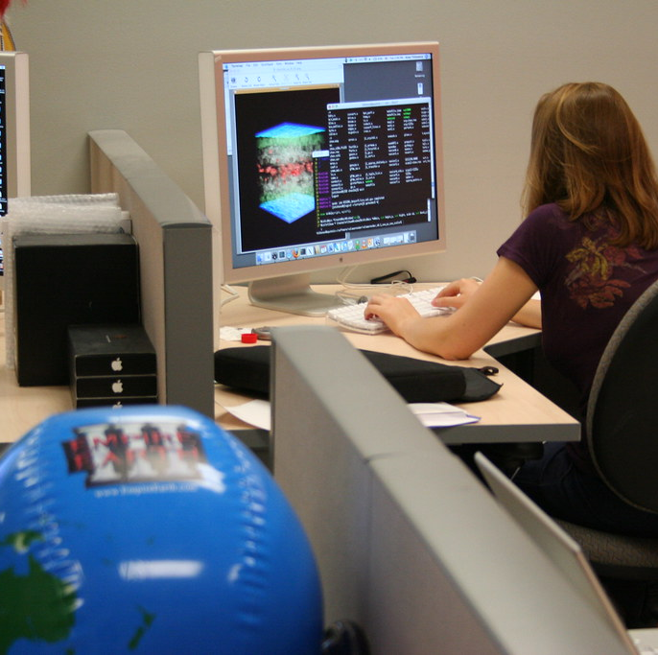
National 5
Computing Science at all levels consists of 4 units but we only study 3:
  Software Design and Development
  Computer Systems
  Database Design and Development
  Web Design and Development

Slide 4

Assessment
 | N5 Computing Science
Practical | Assignment with two tasks set by the SQA each year 33% of their final grade
Theory Exam | Exam with one mandatory section on Software Development and Computer Systems and one optional section chosen from Web Design or Database Design 67% of their final grade

Slide 5
Practical Assessment
Candidates complete this in class over 10 periods.
Usually starting at the end of February/start of March.
Completely open book so candidates have access to every note provided by teachers as well as every piece of code they have written throughout the year.
Two tasks set by the SQA each year:
Software
  Candidates receive a problem description and have to answer some analysis questions, produce a design for part of the program, then follow a design provided to implement the program and finally test and evaluate their solution.
Databases
  Candidates are given a database description and are required to answer some analysis questions and produce some working SQL statements to query the database

Slide 6
Theory Exam
Completed under normal exam conditions as set by Qualifications Scotland.
90 minutes.
Covers all topics over two sections:
Section 1: Software Design and Development and Computer Systems
    As well as theory questions, candidates will be required to write short sections of python code in the exam.
    “Design technique” questions can also be answered in python at this level.
Section 2: Databases
    Candidates will have to read and design SQL queries and answer theory questions
The paper will also have a Section 3 (Web Design) which our students do not need to answer.

Slide 7
Revision Resources
In addition to notes in Class Notebook and Teams, these resources are available to support revision:
  Past Papers, Past Assignments and Marking Schemes
  Achieve
  Mr Neil Computing Science
  Revision Booklet
  N5 Course Specification
  Replit (online python compiler that allows you to save code)

Slide 8
Revision Techniques
To support your child in revising for Computing Science you could:
  Have them explain a section of code to you, going through each line and explaining what it does. (Either code they have written in class or one of the examples provided by their teacher).
  Have them teach you how to write the standard algorithms:
    Input Validation
    Keeping a running total
    Traversing an array
  Utilise AI to produce N5 level coding tasks for them (if they have exhausted our resources).

