Slide 1

Study Support
Linlithgow Academy

Slide 2
Aims
To explain the importance of effective revision
To provide practical examples of effective revision techniques
To support the creation of effective study habits and environment

Slide 3

Overview
Study Skills – Mrs Bryson
Breakout and discussion time
  Bright Red publishing – revision materials
  Mrs Bryson – available for QA
Subject specific inputs ( signposted)
Got a question?
Pop it on a post it note and hand to me/ any staff and we will attempt to answer it at the end!

Slide 4
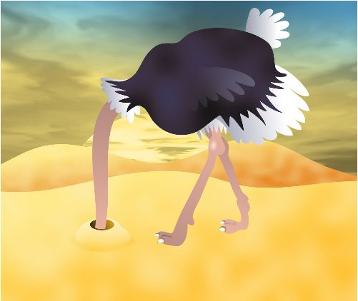




Where are you now?
Settling in task
Around the booths and at the back are some pictures – have a brief walk round and pick a picture which best represents how you feel about your involvement in your learner’s studies
Now on a yellow post it write WHY you feel this way and stick it on the picture

Slide 5

Why are we doing this?
'Learning-centred parental engagement: Freire reimagined' – Janet Goodall, 2017
School staff and parents participate in supporting the learning of the child
School staff and parents value the knowledge that each brings to the partnership.
School staff and parents engage in dialogue around and with the learning of the child
School staff and parents act in partnership to support the learning of the child and each other
School staff and parents respect the legitimate authority of each other’s roles and contributions to supporting learning
This is a step away from the traditional teacher/ learner/ parent model
Parental and family engagement is a key factor in helping all children and young people achieve the highest standards whilst reducing inequity and closing the attainment gap. (2019 NIF)

Slide 6

'Studenting'
There is a 'distance' between teaching and learning
For effective learning Students are instructed on their role- they are the 'primary source of knowledge and skill'
Teachers provide the opportunities and conditions to bring this about but it is a partnership with learners- they must take on a responsibility share of their success and failures

Slide 7


Why are we doing this NOW?
Winter Assessments start 23rd Nov
Final Exams 26th April
Results
  New revision techniques/ approaches can be beneficial
  Sustainable improvement

Slide 8



Why Revise?

Slide 9
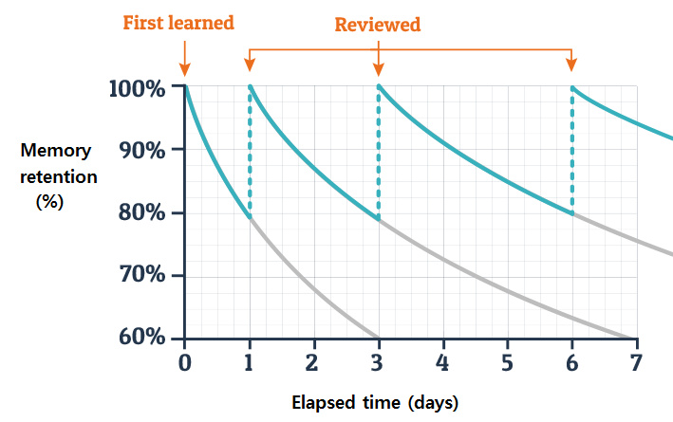
Why revise?
Ebbinghaus forgetting curve
We start losing the memory of learned knowledge over time, in a matter of days or weeks, unless the learned knowledge is consciously reviewed time and again.
You cannot expect to just ‘remember’ stuff lesson to lesson or across the year. You have to engage your brain in RETRIEVING of REVISING information to help it stick
Doing this in manageable intervals is proven to work

Slide 10


Education Endowment Foundation- Self Regulated Learning
Research emphasises the need for guided practice, in which the teacher provides support, prompts, and scaffolding, particularly during the initial stages of practice. The pupil can assume more and more responsibility as they become more proficient.
To revise effectively, pupils need revision approaches clearly modelled for them before they gain independent expertise.

Slide 11
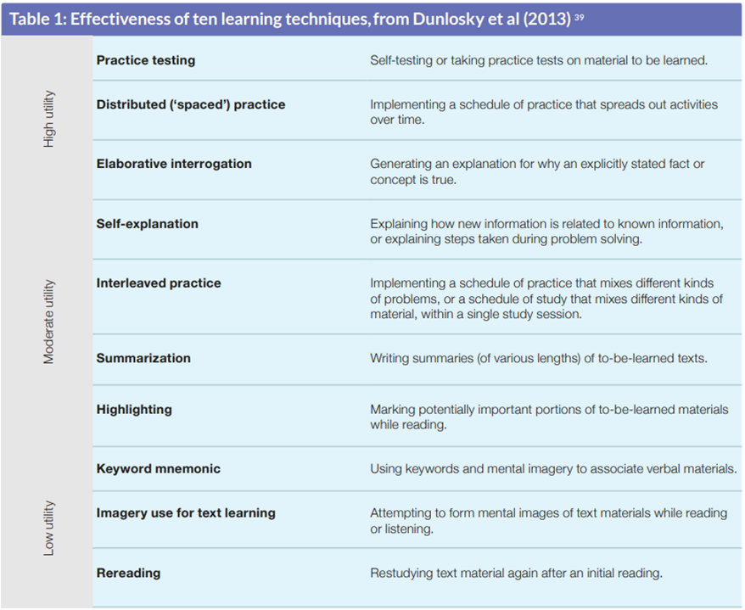
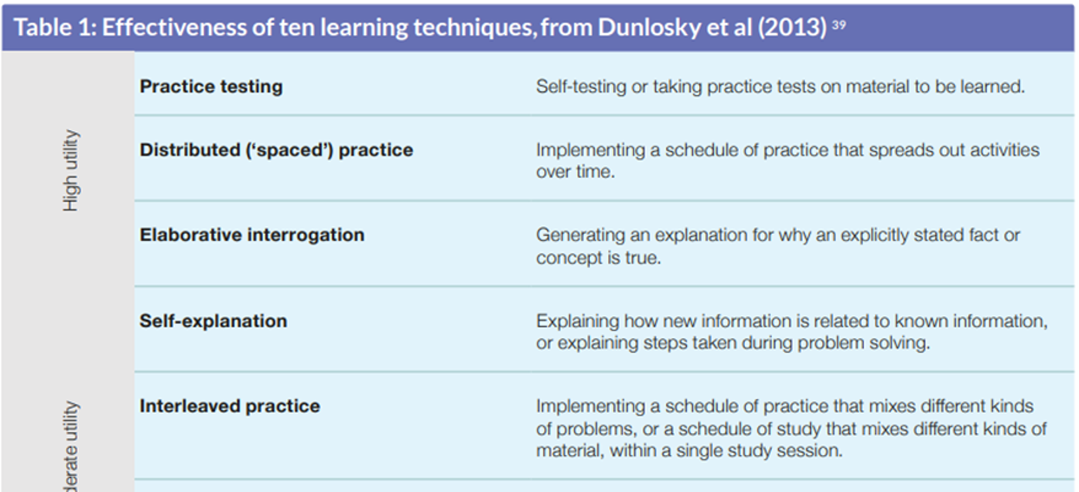

Slide 12





Creating the right atmosphere

Slide 13
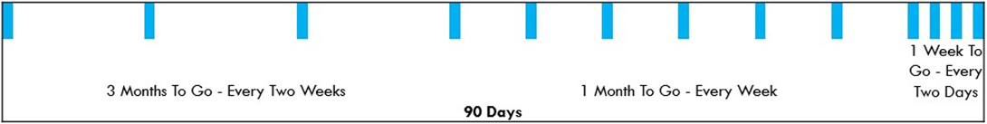
Timing revision
Distributed learning tends to lead to more knowledge retention
It is better to spend 10 minutes revising today and 10 minutes again tomorrow, than 20 minutes today.
Remember to plan this for EACH SUBJECT

Slide 14
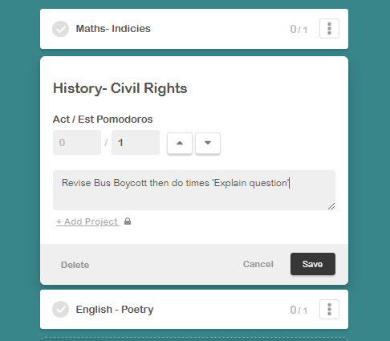
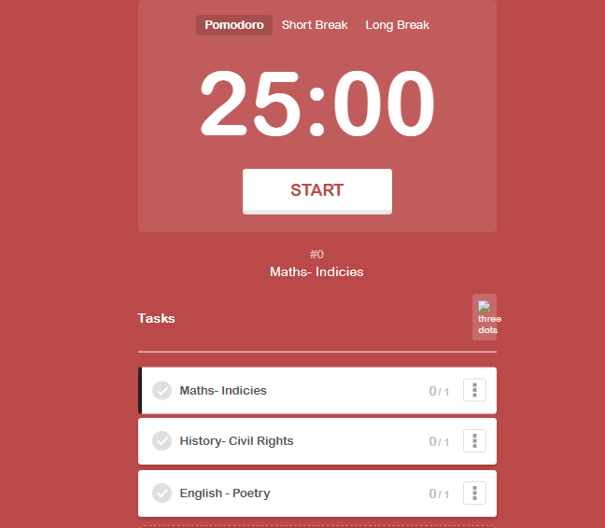
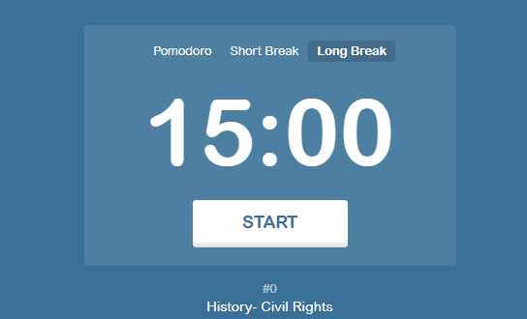
Break it up - Pomofocus
You may wish to encourage the pomodoro method of approaching study – setting timers for e.g. 25 min work, followed by a 5min break. Learners don’t have any distractions in work time e.g. phones, but can do what they like in 5 min break.
https://pomofocus.io/

Slide 15

Exam Stress
Watch out for exam stress/anxiety and be aware of the signs. Signs of stress can include:
  Being irritable
  Sleeping poorly
  Loss of appetite
  Worrying
  Feeling negative
  Headaches and stomach aches
  Support available in school

Slide 16

What methods prove effective when studying?
Practical examples

Slide 17

Cops and Robbers- Practical
Split a page in 2 columns. One is COPS, the other ROBBERS
You have 1 minute ON YOUR OWN to write down/describe as many EFFECTIVE study techniques have heard of
  note these in the ‘Cops’ section
NOW- you have 1 additional minute to ‘Rob’ some ideas off another person at your table
This is a great technique for supporting learning of sub-topics, short answers, quotes etc.
You can support at home by co-creating an answer key which can then be used in the 'Rob' phase

Slide 18


Collaborative Learning
Some ideas
Teach one
  Ask your learner to prepare a 5- 15 minute lesson on a topic they find particularly difficult. Ask your child to prepare a list of key facts they will need to cover beforehand and make sure you have a copy of it. Be prepared to ask your learner questions.

Slide 19
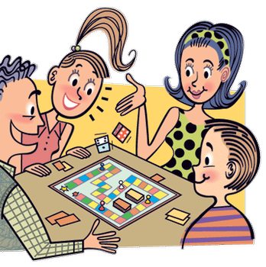

Collaborative learning techniques
Scribe
  Get your child to pick a past paper question to do. But instead of them writing it you can scribe for them. Articulating their answers in a clear way will help learners organise their thoughts. Use the past paper marking schemes to check knowledge when done
Play a game
  Encourage your learner to create an interactive game (snakes and ladders will do). Progression in the game depends on correct answers!

Slide 20
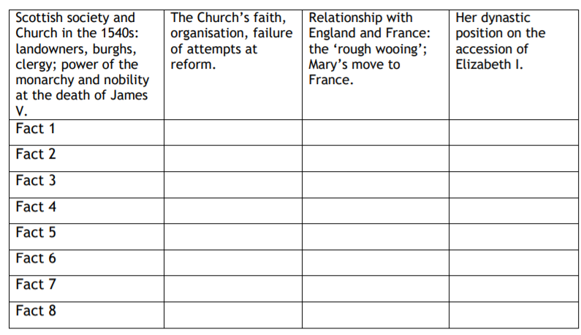
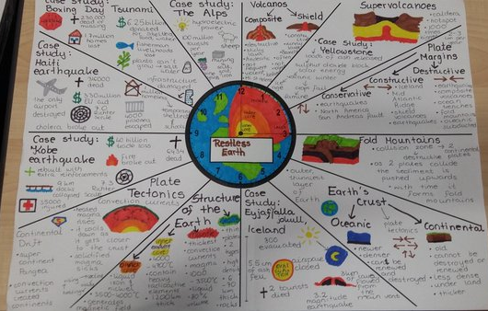
Clocks/ Fact catchers
Fact Catcher
  A useful tool for when you are revising questions that require several points of recall.
  Points can then be turned into a quiz
Revision Clock
  Instructions –
  Break down topics into 12 sub-topics.
    In each segment you can make or illustrate diagrams and summarise key information.
    Each segment has a 5 minute time limit, in order to break down learning into smaller pieces.
    Like above, this can form the basis of a quiz or flashcard creation

Slide 21
If this is the answer…?
Opposite are a list of words connected to what we have discussed so far
You need to create a QUESTION for which the key word is the answer.
  Example - if the answer is ‘Eight to ten weeks’ the questions could be ‘How long did the Middle Passage take on average?
Once you have created your questions, ask them to your partner- can they give the correct key word answer from your questions?
Again, this is an effective collaborative technique for when your learner need to revise dates, names, formulas or other short KU answers. Ask your learner to make a list of key words then test them using this technique
Resilience
Atmosphere
Forgetting curve
Fact Catcher
Clock
Robbers
Stress

Slide 22
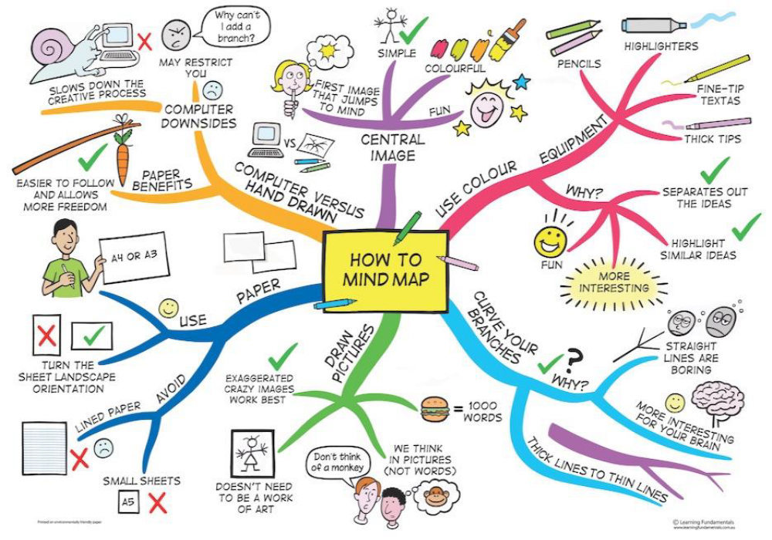
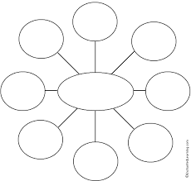
Example – mind maps
NO!!!

Slide 23
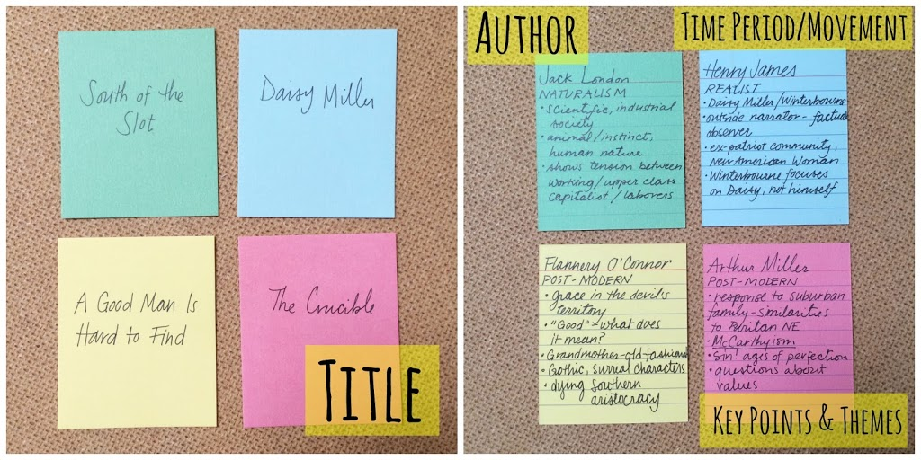
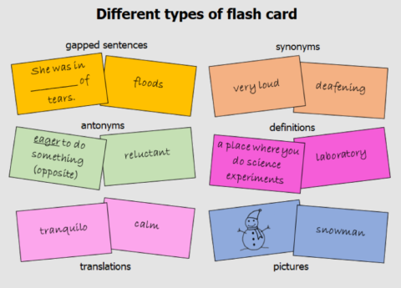
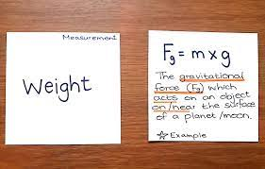
Flash cards
These are a great tool to use with your learner
Using flashcards to self-test helps learn information, and helps to identify any weak spots your learner may have with the material.
Preparation is key!
VIDEO- effective Flashcards
  https://youtu.be/mzCEJVtED0U

Slide 24




Why is it a good idea to use past papers?
Timing
Language
Marks
Reflection

Slide 25

How can past papers be used effectively?
Complete under timed conditions – set a timer and complete the question/s in exam conditions
When answering the questions RAG rate as you complete them ( or before!)
After the paper, mark your questions
  Questions should help learner identify areas to focus revision on

Slide 26

Nightmare before the exam...
Use available past papers to create a 'nightmare' paper and tailor revision towards this
Why?
  It's easy to study the stuff that is known, it's better to study the stuff that is hard
Staff across the school are very willing to mark individual questions

Slide 27
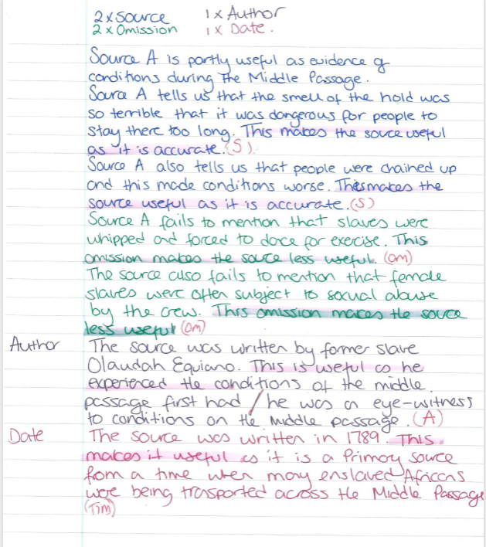
Model answers
Use past papers WISELY
Use the marking schemes to create MODEL answers question types or topics you find hard.
Once you have them MARK them – highlight out what would get a mark and where- your teacher can help
Once you have done this, attempt the question for real and then check your answers.

Slide 28

Digital Tools
Notes:
Hello and thank you for giving us the opportunity to speak to this evening about OneNote, my name is Andrew McGlen and this is my colleague Jackie Campbell, and we are the current Digital Leads within the school.
During tonight’s presentation, we would like provide you with a:
general overview of OneNote,
shares with you some of the many, many benefits that OneNote brings to learners and educators
a sample of the various multimedia features which can included within an individual OneNote page
Additionally, we would like to share with you some information about the progress we’ve made in relation to the use of digital since taking up our role 12 months ago, along with our future vision.
Finally, we would like to speak briefly about some of the digital learning tools which are available via the Glow platform to help support your child with their learning.

Slide 29
OneNote Overview
Digital notebook
Pages are stored in sections
Now widely used in education and industry
Teachers can share learning resources in the Content Library
Accessible on a variety of enabled devices – Anywhere, Anytime Learning (AAL)
Notes:
So, what is OneNote?
Put simply, OneNote is a digital notebook, that replaces the traditional notebook or file system.
It allows users to access and create pages which are stored in individual sections of particular notebook.
The software application is widely throughout education, including further and higher education, and now industry too.
By regularly using OneNote from an early age, your child is able to develop a range of digital skills that they’ll be expected to demonstrate and apply in their future education, work and life.
From an educational point of view, OneNote offers so many benefits to both learners and teaching staff – I’ll speak more most of these on the next slide
However, one key benefit is that teachers can store their learning resources and tasks in the ‘Content Library’ section of a Notebook. This means that your child can gain access to these vital resources as and when they need them, even when they’ve been absent from class.
OneNote can be accessed on a range of internet enabled devices including:
PC, Laptop, Tablet PC and Smartphone, offering Anywhere, Anytime Learning opportunities for your child.

Slide 30
Why OneNote?
Single Resource Location
Multimedia Content
Built-in Tools to Support Learning
Equipping our Learners for the Future
Share & Collaborate
Notes:
So why have we chosen OneNote?
One of the greatest benefits of using OneNote, is the ability for learners to have all of their learning resources for a particular class, stored in one single location.
Gone are the days when your child needs to carry with them multiple folders, jotters and loose piece of papers in their bag. OneNote ensure all of these learning resources are stored safely in one location.
OneNote is a massive game changer when it comes to supporting learners, especially those with additional support needs: Jackie will speak more about these tools later on in the presentation.
Furthermore, it is possible for learners to work with their peers by adding content to pages stored in the ‘Collaboration Space’. It is also easy for teachers to place content and add individual pages each learner’s personal section of their Notebook.
Finally, OneNote, now allows for different multimedia components to be added to pages, make learning more innovative, pupil led and engaging.
Resource handouts are no longer restricted to text and visual content forms.
I’ll share with you an example on the next slide.

Slide 31
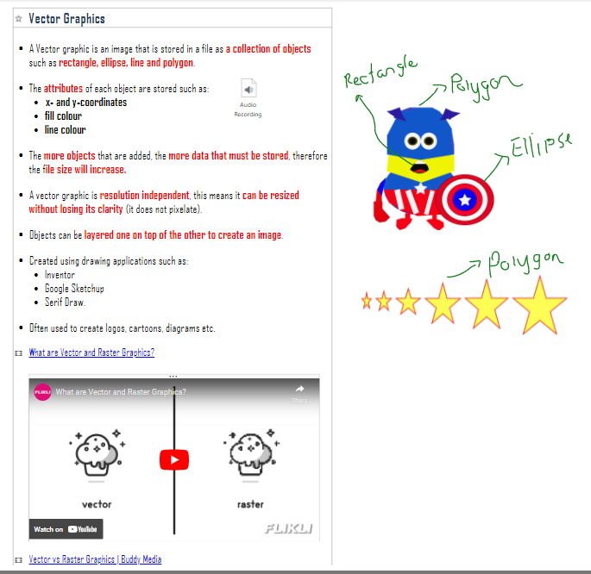
Multimedia
Content
Annotation using Digital Ink
Audio Commentary
Graphics & Diagrams
Text
Video Clips
Surveys & Formative Assessments
Notes:
Audio clips
allows your child to listen to instructions and information about the topic areas they studying in a particular subject
They can even create audio recordings to share their thoughts and understanding of a particular concepts with their teacher and peers
Many teachers are now using their tool provide feedback on your child’s progress.
Digital Inking
Annotate key points and show a deeper understanding what is happening in a text and/or graphic.

Slide 32

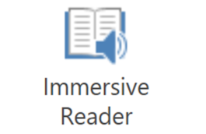



Other Digital Tools – Supporting ALL learners
Microsoft Lens (formerly Office Lens) trims, enhances, and makes pictures of whiteboards and documents readable. You can use Microsoft Lens to convert images to PDF, Word, PowerPoint, and Excel files, digitize printed or handwritten text, and save to OneNote, OneDrive, or your local device.
Notes:
So important that all learners, regards of their support needs, utilise these tools in order to effectively make progress in their learning.
Mention that Office Desktop version is available to download for free via the Glow Launchpad.

Slide 33

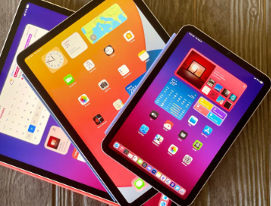



Many subjects and levels represented on both- worth checking in
Helpful for -
Basic content
Past papers/ responses
Quizzing
Self assessment

Slide 34

Homework helps!
S4 – S6 pupils can expect 2 bits of homework a fortnight per subject
All homework is designed to consolidate and explore learning in class. Completion of these tasks can often double as study time!
All homework is issued via Teams

Slide 35
Can AI help revision?
Getting AI to do the work for you, won’t help you learn the information. Use it to revise the information YOU ALREADY HAVE
Do | Don't
Use AI to generate memory hacks and summarise ideas. | Get AI to do your homework. It won't help you learn the information.
Use it to test your knowledge. You could generate quiz questions to practise with. | Use it to write an essay, exam, or coursework for you. WE CAN TELL
Have fun exploring different prompts you could use to help you revise. | Believe every response you get from AI. Fact check everything!

Slide 36
Useful AI tools
Quizlet – Create digital flashcards with games and tests (some features require a paid subscription).
Knowt – free alternative to Quizlet that converts lessons into notes, summaries and quizzes.
Gizmo – free AI-powered flashcard and quiz generator that creates multiple test formats.
Anki – A well-known flashcard generator that uses spaced repetition for long-term memory retention.

Slide 37


Slide 38
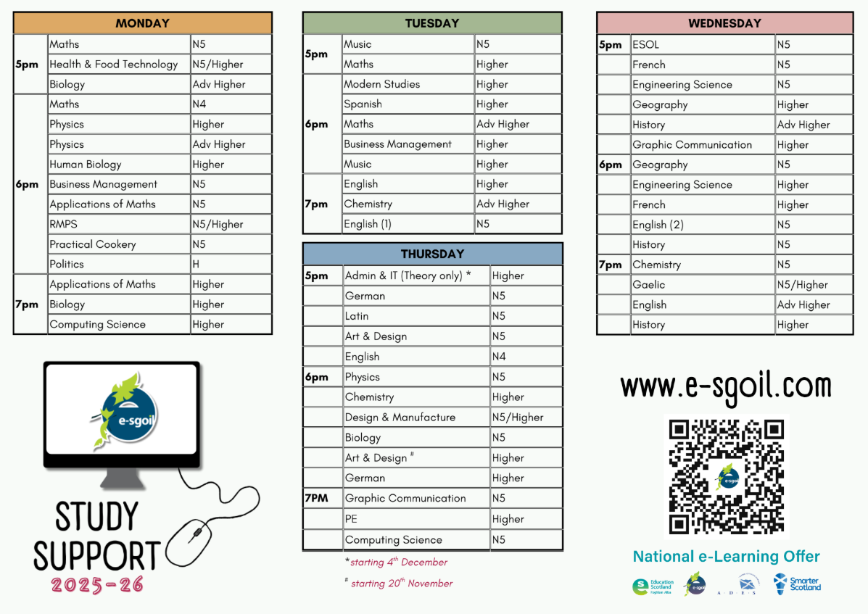
2026-27 going live soon!!

Slide 39
Useful SQA links
Access past papers and marking schemes directly from SQA website
https://www.understandingstandards.org.uk/ ( not just for teachers!)
SQA Course specifications - this is your revision checklist!

Slide 40

Resources
Study skills booklet ( On school website, see QR code)
https://education.gov.scot/improvement/learning-resources/why-get-parents-involved/
https://education.gov.scot/parentzone/learning-at-home/supporting-study/
SQA Support for parents - https://www.sqa.org.uk/sqa/41292.html
BBC Bitesize
SQA – Past Papers

Slide 41
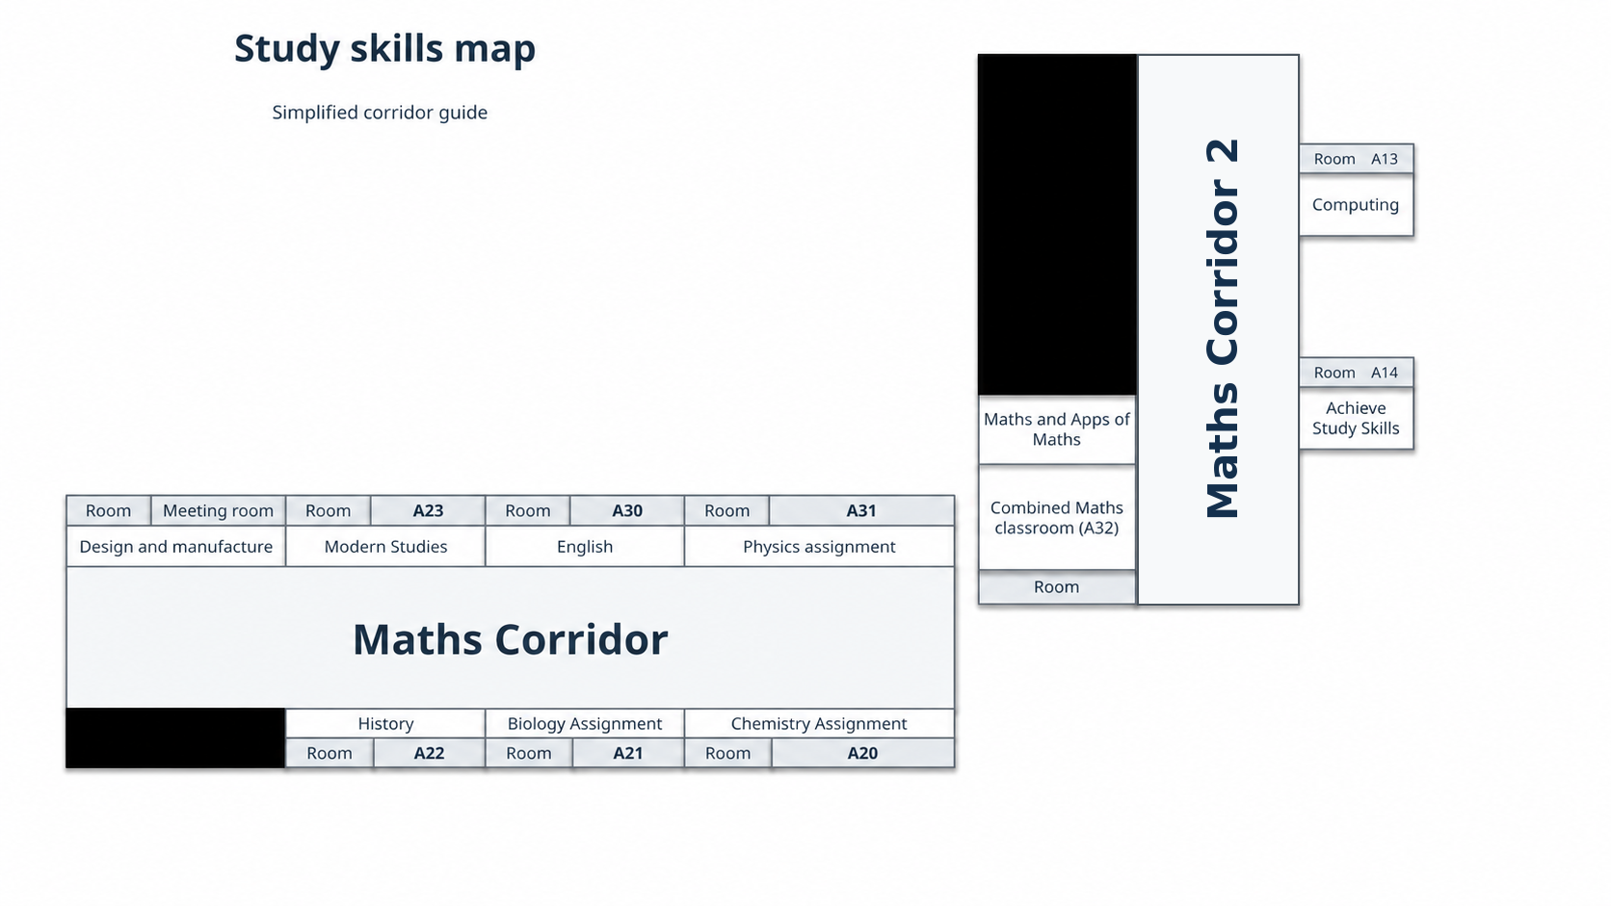

Slide 42
Where are you now?
Exit task
Around the room are some pictures – have a brief walk round and pick a picture which best represents how you feel about your involvement in your learner’s studies after today’s session
Now on a PINK post it write WHY you feel this way and stick it beneath the picture on your way out!

