Slide 1
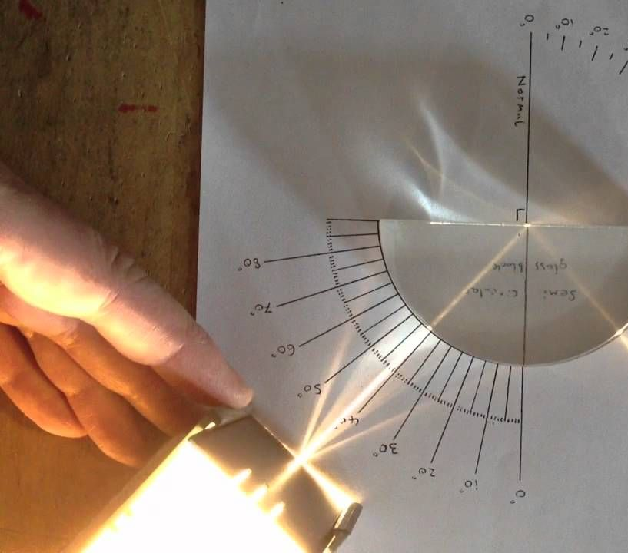
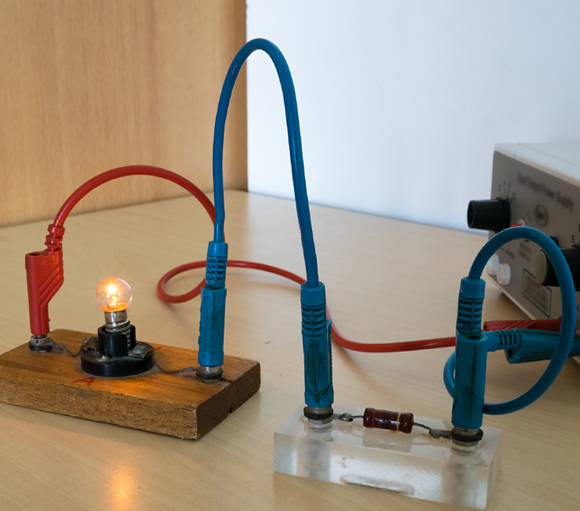
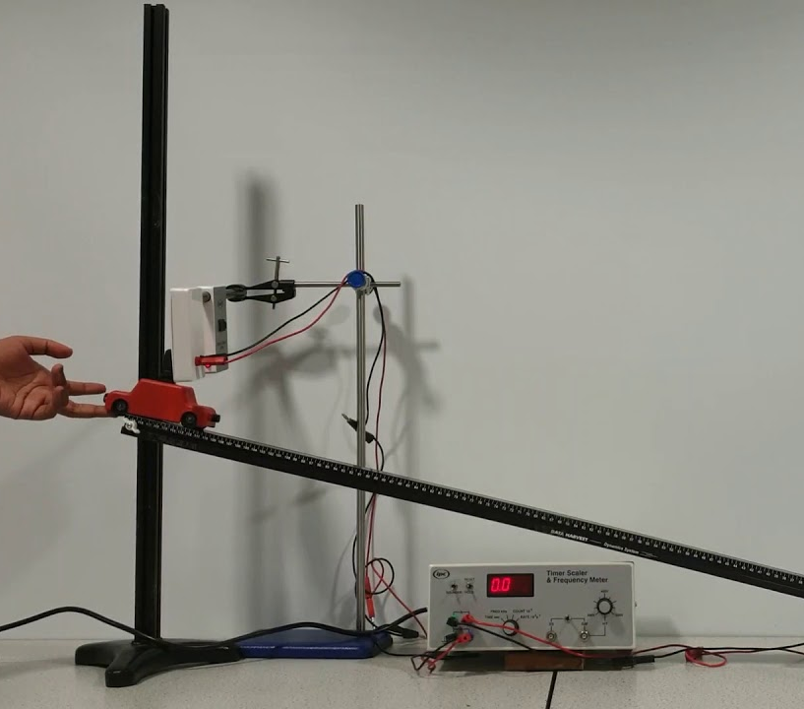
Nat 5 Physics Assignments
How you can you help?

Slide 2
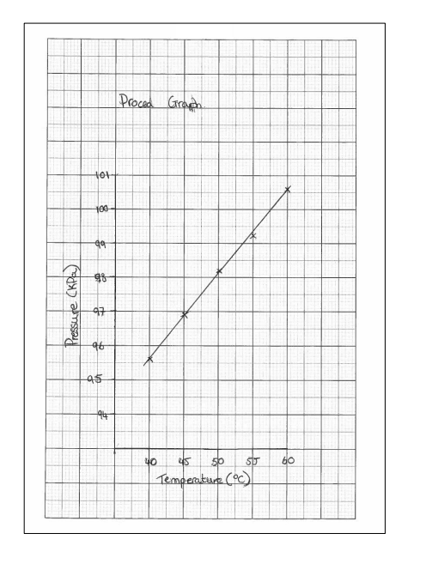
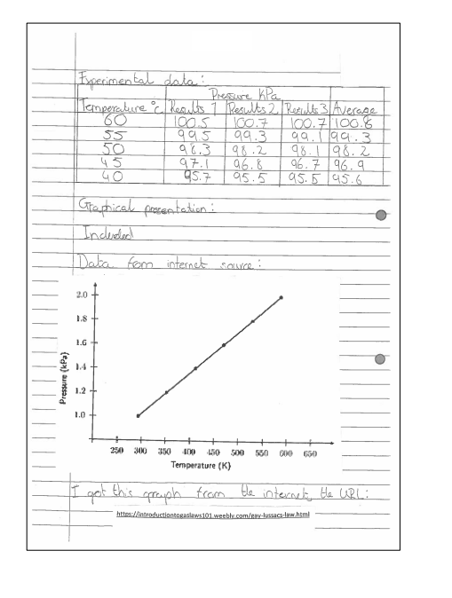
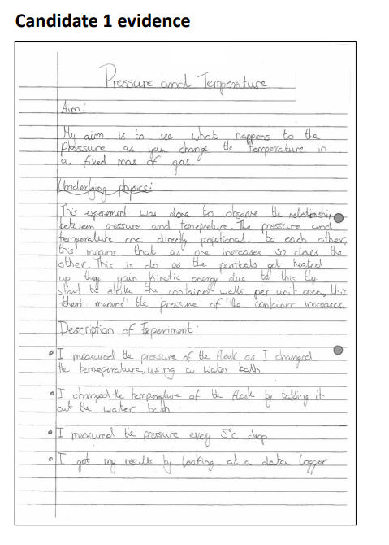
Example Assignment
What is the
assignment?

Slide 3
National 5 Assignment
20 marks (scaled to 28). Worth 20% of overall marks.
8 hours, of which a maximum of 1 hour and 30 minutes is allocated to the report stage​
Notes:
Exam – 110
8 hours in class
3

Slide 4
Research Stage
Reporting Stage
Experiment
Data from internet
Physics Research
Practice at home
Write up report formally
In class
Exam conditions
Notes:
Only allowed raw data, data source and reference and some info from internet.
4

Slide 5
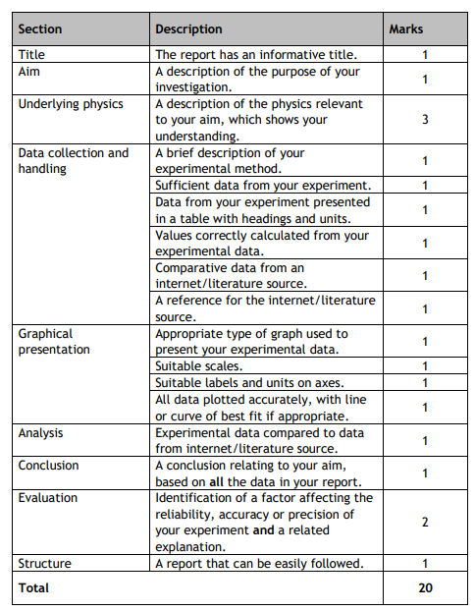
National 5
National 5 Physics Assignment
Assessment Task
Acceleration,
Projectile
Refraction
Gas Laws
Current, Voltage, Resistance.
Notes:
Warn them against the use of AI.
5

Slide 6
Assignments will be starting in January
At home:
Discuss how their experiment has gone
Researching background Physics
Practicing their report (no feedback from teachers)
Checking understanding standards
Looking at marking scheme and guidance from SQA

Slide 7
Examples of things to look out for when helping at home:

Slide 8
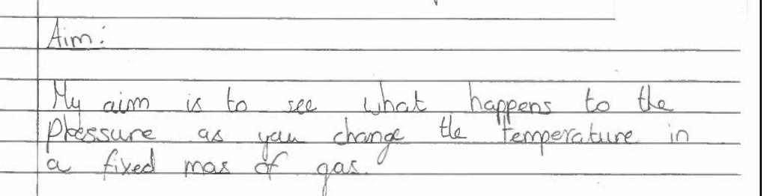
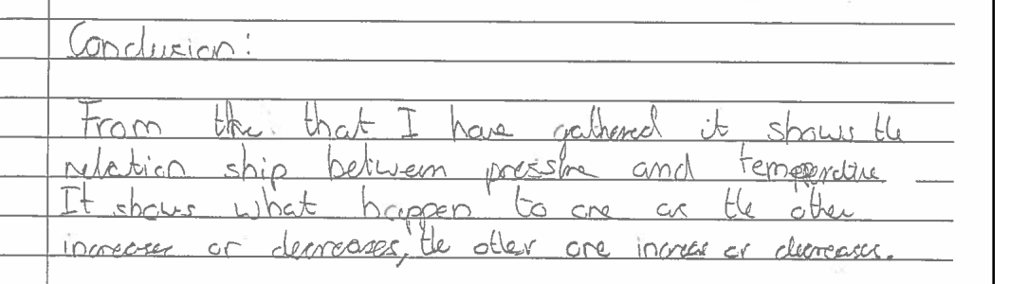
Notes:
Not answered their aim.
8

Slide 9
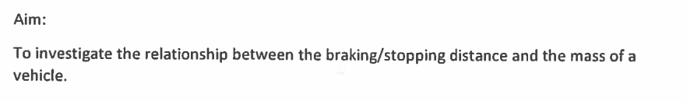
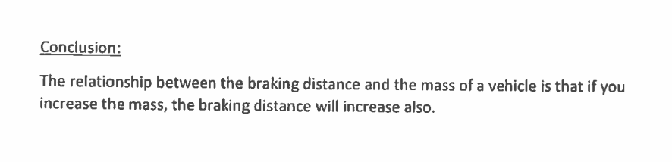
Notes:
The word relationship
9

Slide 10
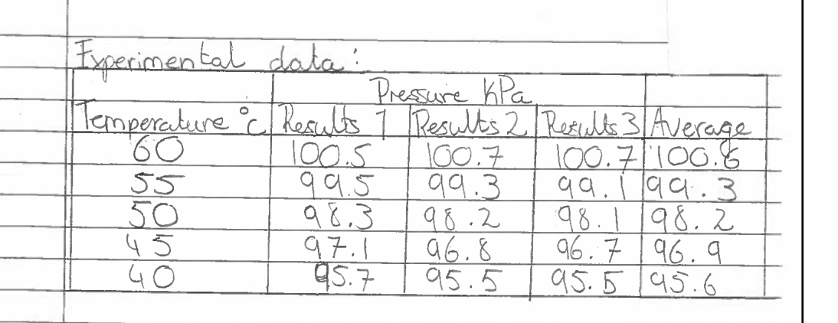
Notes:
Units of last column
10

Slide 11
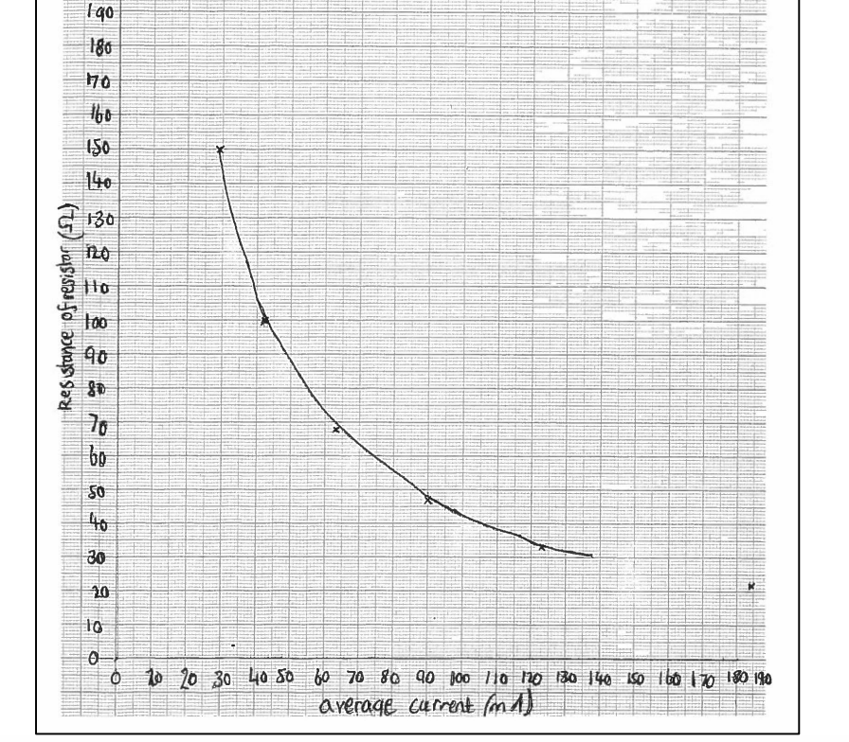
Notes:
Line doesn’t extend to full range of data
11

Slide 12
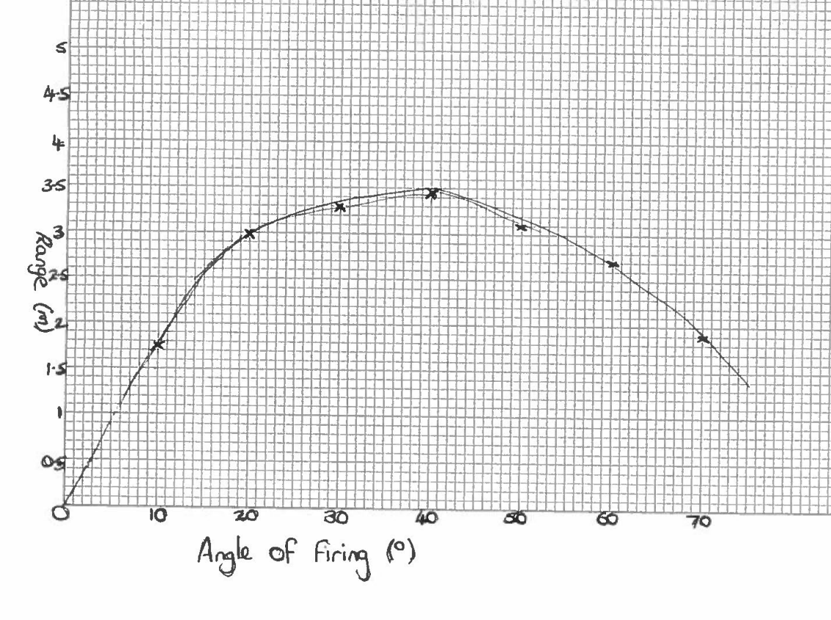
Notes:
Not accepted line of best git
12

