Slide 1
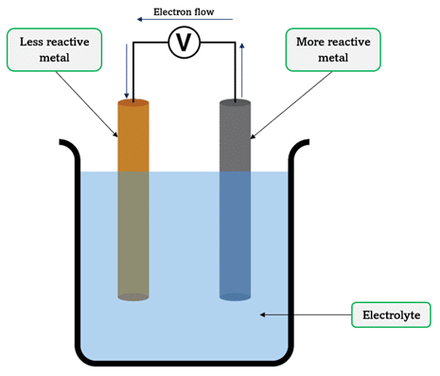
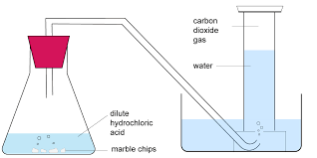
N5 Chemistry Assignment
Information Evening
Wlrosa.fernandez1@glow.sch.uk

Slide 2
Aims of session
Overview of the assignment task and process
Where to find useful resources
How you can support your child at home
Q & A

Slide 3
What is the assignment?
One of two components of the final course assessment
Worth 20% of the overall grade (20 marks).
Skills Assessed
    • Planning and conducting experiments
    • Processing and analysing data
    • Applying chemistry knowledge
    • Drawing conclusions and evaluating methods
    • Communicating findings clearly

Slide 4
Structure of the assignment
Two stages:
• Research: experiment + internet/literature research
• Report: written under exam conditions (sent to SQA for external marking)
Conducted over no more than 8 hours (in class), with 1 hour 30 minutes for the report.

Slide 5
Research Stage
Pupils choose a topic with teacher guidance. This must include:
• An experiment with measurable data
• Comparative data from books/internet
• Chemistry explanations supported by extracts
• Group work allowed for experiments (2–4 pupils), but analysis is individual.
Notes:
Carried out in class but pupils can do unlimited work at home. Have full access to detailed marking instructions.

Slide 6
Report Stage
Completed under exam conditions. Pupils use:
  • Raw experimental data
  • Comparative data with references
  • Chemistry extracts (verbatim, unannotated)
  • Candidate guide (instructions)
  No drafts, notes, or internet access allowed during this stage

Slide 7
When?
January.
Around 9 periods in class for Research. (6.5 hours)
1.5 hours for Reporting (write up).
Students allowed Extra time in the exam, still will get extra time for the assignment.

Slide 8
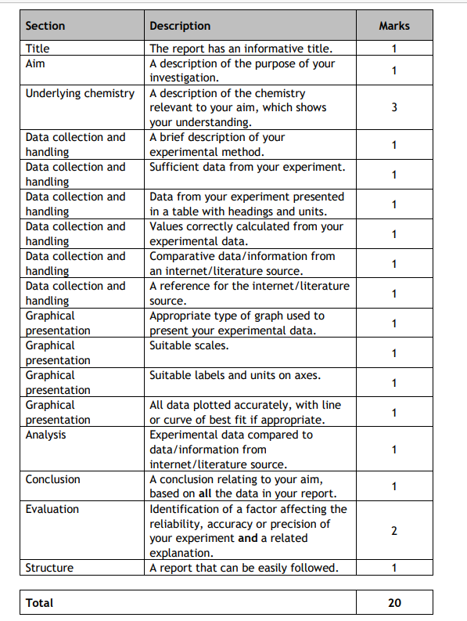
Summary

Slide 9
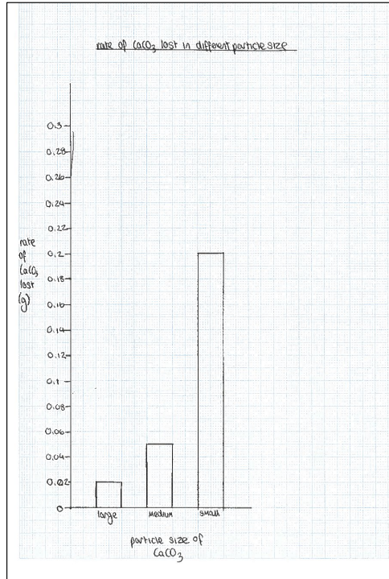
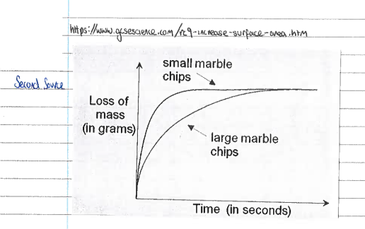
How you can support
At home pupils are encouraged to:
Find reliable sources to use as their extracts (to support the writing of their underlying chemistry) and their comparative data source.
Pupil experimental data
Second data source (for comparison)

Slide 10
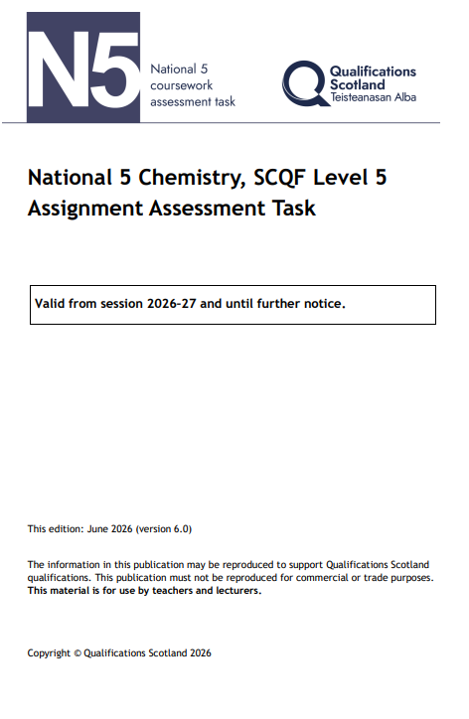

Practice writing their assignment. Particularly calculations, graph, tables etc.
Look over the full marking instructions.
Full marking instructions
https://www.sqa.org.uk/sqa/files_ccc/n5-cat-chemistry.pdf
Notes:
Nothing stopping pupils rehearsing and preparing well at home before the report stage .

Slide 11
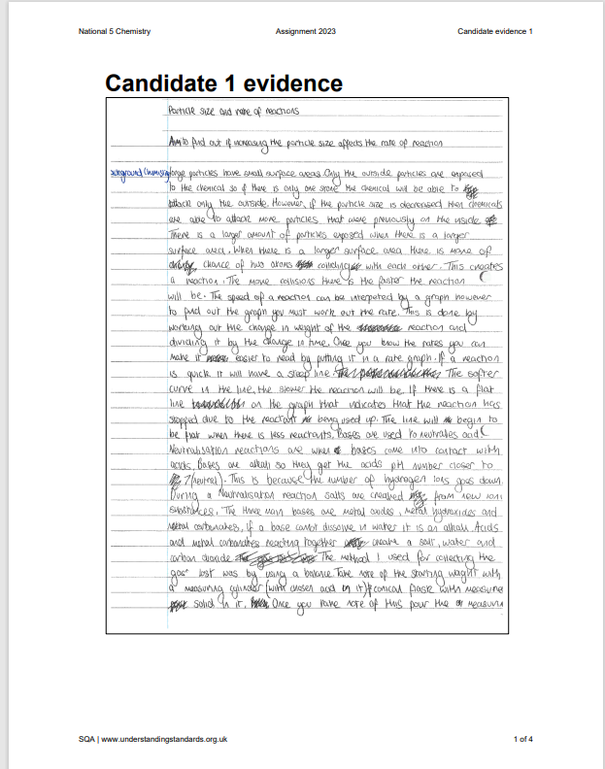

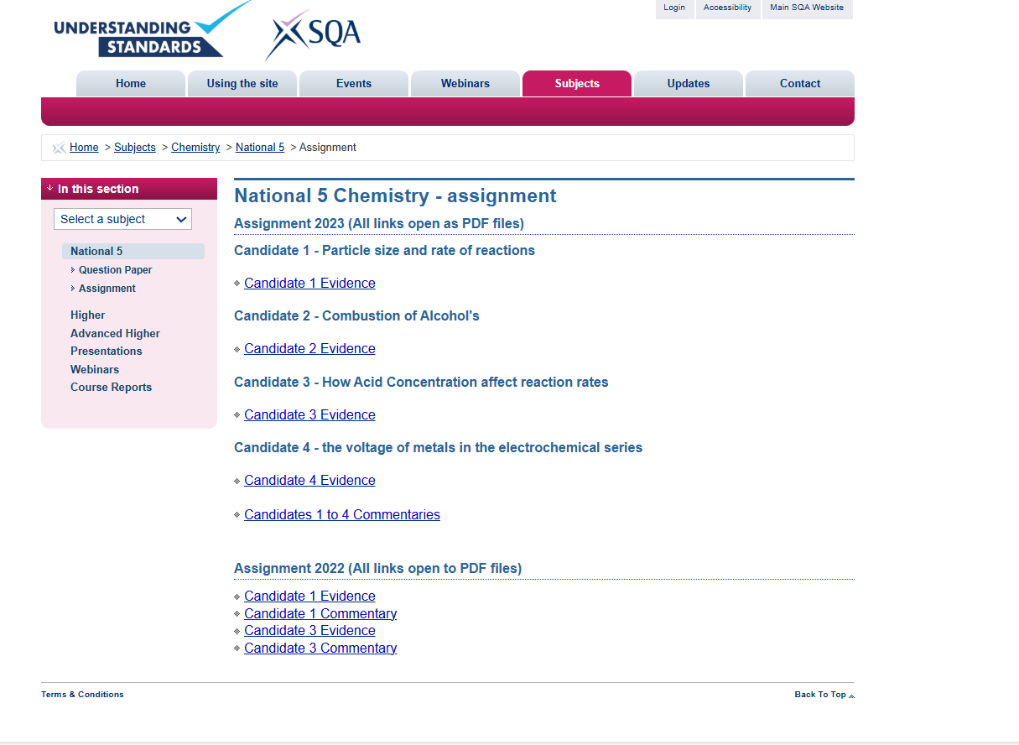
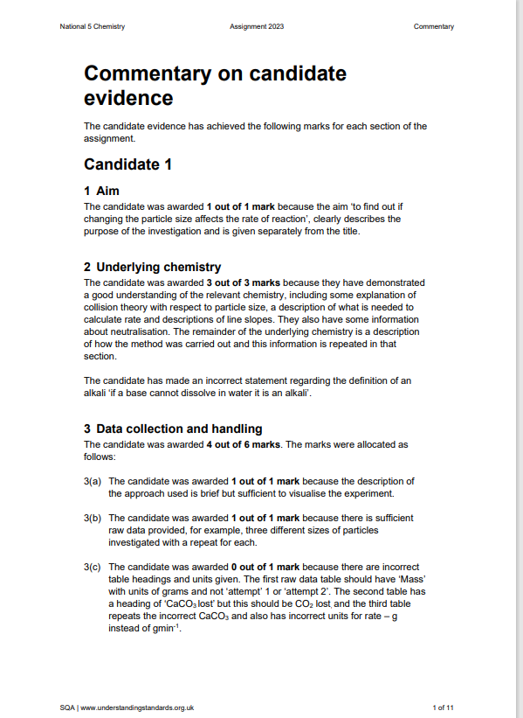
Use the Understanding Standards website to look over example assignments and commentaries.
SQA - Understanding Standards: Assignment

Slide 12

Questions?

