Slide 1


Welcome to Modern Studies

Slide 2
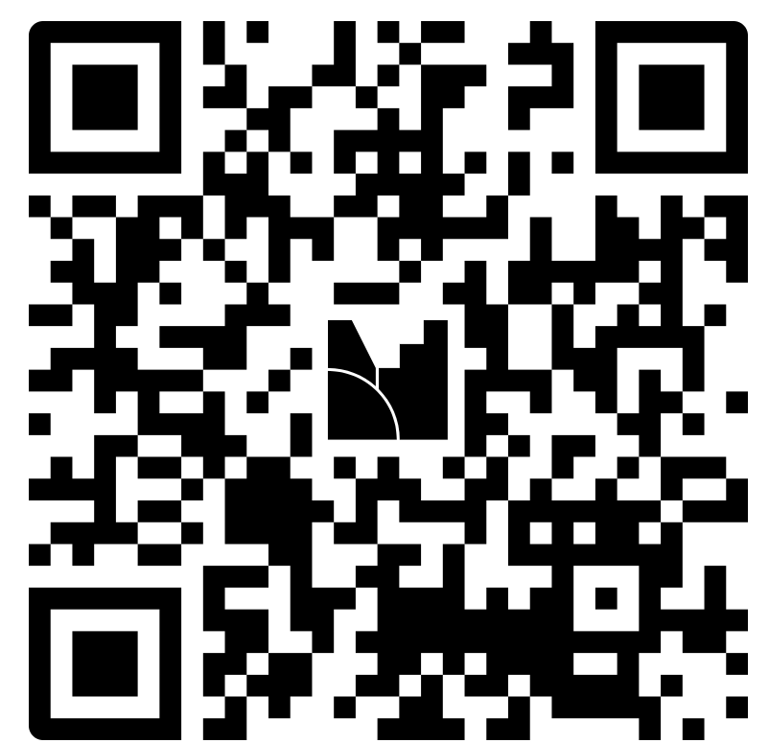
What is Modern Studies?
Feel free to scan the QR code and pop your ideas down!

Slide 3
What is Modern Studies?
Contemporary political and social issues in local, Scottish, United Kingdom and international contexts.
Candidates develop the skills to interpret and participate in the social and political processes they will encounter in their lives.
Social Issues: Crime and Law
Democracy in Scotland
World Power: China

Slide 4


Aims of the Session
To give you a better understanding of how you can support your young person to prepare for their assignment write up.

Slide 5
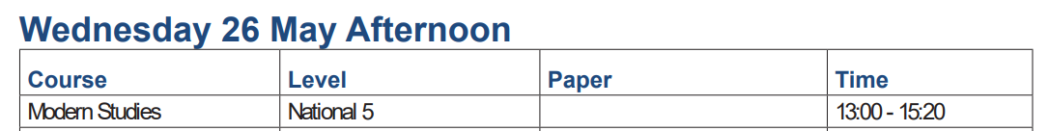
Components of the Modern Studies Courses
Exam (1 paper) worth 80 marks (2 hours and 20 minutes) 80% of Final grade
2. Assignment worth 20 marks. (1 hour)
20% of Final grade

Slide 6

CURRENT PROGRESS
National 5 will commence research in December 2026.
10 periods of class time dedicated to research
Strongly advise pupils to utilise time in class effectively

Slide 7
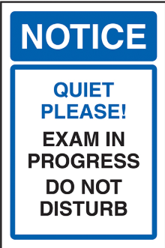
Final Write Up Dates
National 5
Miss Livingston: Monday 9th March 2026 P6&7
Mrs Meek: Tuesday 10th March 2026 P6&7
Mock write up:
W/C 02/03/2026 – learners will have an opportunity to practise writing their assignment with only their research sheet (this will need to be completed in class time.
Students will have 1 hour to complete their write up.
This will be done in class time during the double period under formal SQA exam conditions.
AAA arrangements will be in place for students who usually receive these.

Slide 8
Final Write Up
Students will have 1 hour to complete their write up.
This will be done in class time during the double period under formal exam conditions.
AAA arrangements will be in place for students who usually receive these.

Slide 9

Teacher Input
Qualifications Scotland has very strict guidance on how much input and direction the candidates can be given. Therefore, teachers are not allowed to mark drafts.
Teachers are permitted to look at drafts and provide “progress checks.”

Slide 10
What is the N5 Modern Studies Assignment?
Candidates choose a topic or issue which allows them to analyse a Modern Studies or contemporary issue.
Must not be moralistic/ philosophical.
They research the issue and organise their findings to address the topic, using the specified resources collected during their research to support them in the production of evidence.
The research stage is designed to be capable of completion over a notional period of 8 hours (10 periods in class).
Then the rest will be completed at home.

Slide 11
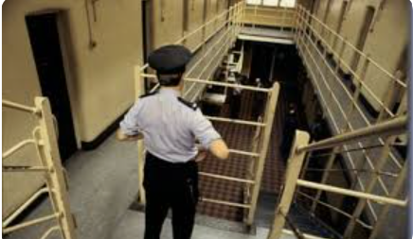


What is the N5 Modern Studies Assignment?
Modern Studies topics/issues:
Examples:
Prisons – overcrowding/early release etc.
Health – Drug Treatment Centres/legalisation of certain drugs
Scottish Independence
Causes of Crime
Privatisation of the NHS
Should all Police be armed
Education - private schools, Free School meals

Slide 12
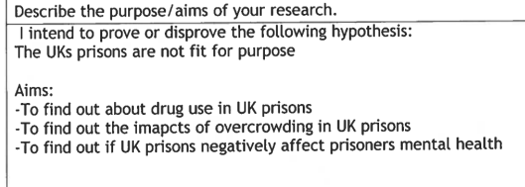
National 5 Candidates (Suggested Structure)
Title:
Hypothesis: (statement that you will prove/disprove through the course of your research).
Aims:
1. Arguments for/to find out…
2. Arguments against/to find out..
3. Public opinion/to find out…
Or
Research Methods: strengths, weaknesses, and what would you do differently?
Findings: What did your research tell you about the issue? What evidence do you have to support this?
Conclusion: In conclusion it can be argued that………………….because……………….

Slide 13
Higher Candidates (Suggested Structure)
To: Neil Gray
From: Heather Livingston (Advisor to the Government)
Subject: Tackling Childhood Obesity Epidemic in Scotland
Introduction/Framing the Issue (10 marks)
Option 1: Compulsory daily PE in schools
Option 2: Ban on the sale of fizzy drinks to under 16s
Option 3: Early interventions programmes
Recommendation: After careful consideration I recommend that the Scottish Government funds early intervention programmes in school to tackle the obesity crisis in Scotland.
Arguments to Support Option 1:
Arguments to oppose option 1:
Arguments to Support Option 2:
Arguments to oppose option 2:
Arguments to Support Option 3:
Arguments to oppose option 3:
Conclusion:
Research Methods:

Slide 14

Research Sheets
The purpose of the research sheet is to help candidates use their evidence and references, collected during the research stage, to address their chosen topic or issue. The research sheet should not take the form of a ‘plan’ as this is likely to encourage direct copying, which gains no marks.
Candidates should use the research sheet (two single-sided sheets of A4) to provide evidence that they have carried out their own research.
Candidates must not use it as a plan. Direct copying from research sheets attracts no credit and, where research evidence is not identified, full marks cannot be achieved.
Any ‘coded’ research evidence will also be treated as direct copying.
If an N5 candidate does not submit their research a penalty of 4 marks is applied.

Slide 15
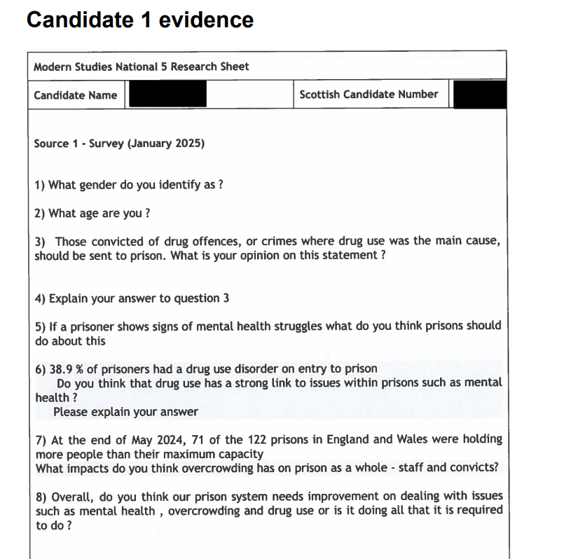
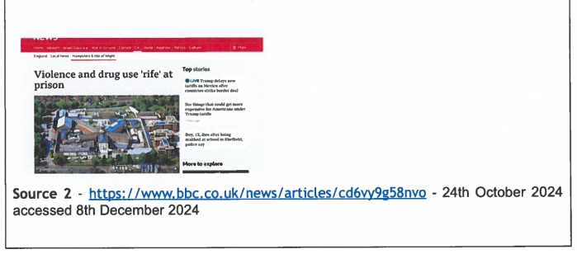
Research Sheets
The Modern Studies research sheet should show evidence of primary or secondary research carried out by the candidate. It may include, for example:
Statistical, graphical or numerical data
Survey results interview questions and/or answers
Questionnaires and/or results
Newspaper articles or extracts
Notes taken from a visit, talk, or a written or audio-visual source e.g. Podcast, YouTube video etc.

Slide 16
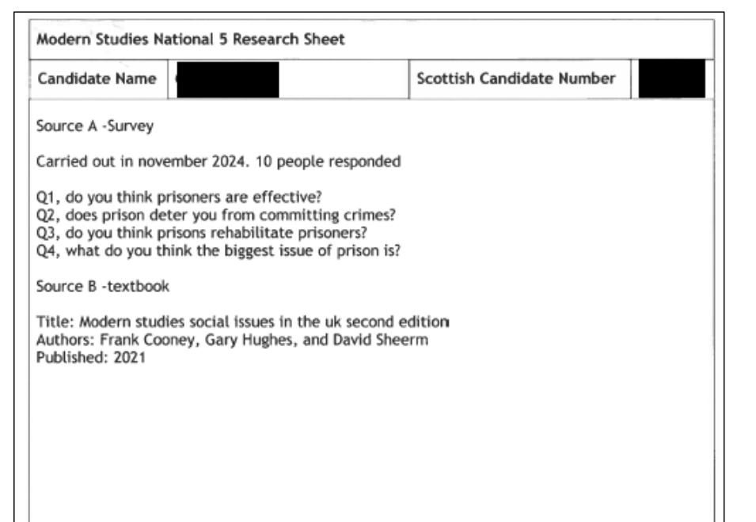
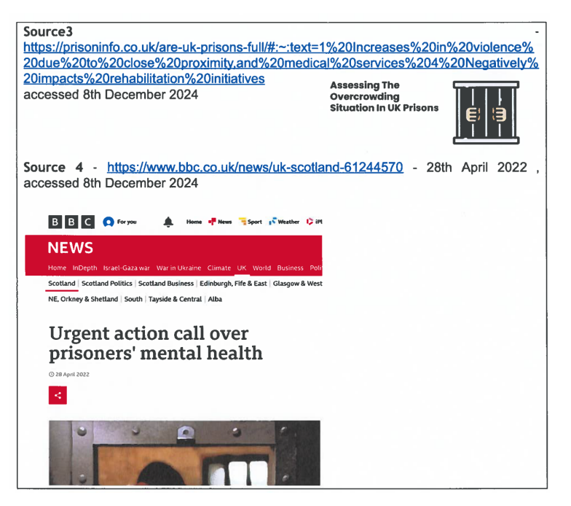
Examples of Research Sheets

Slide 17
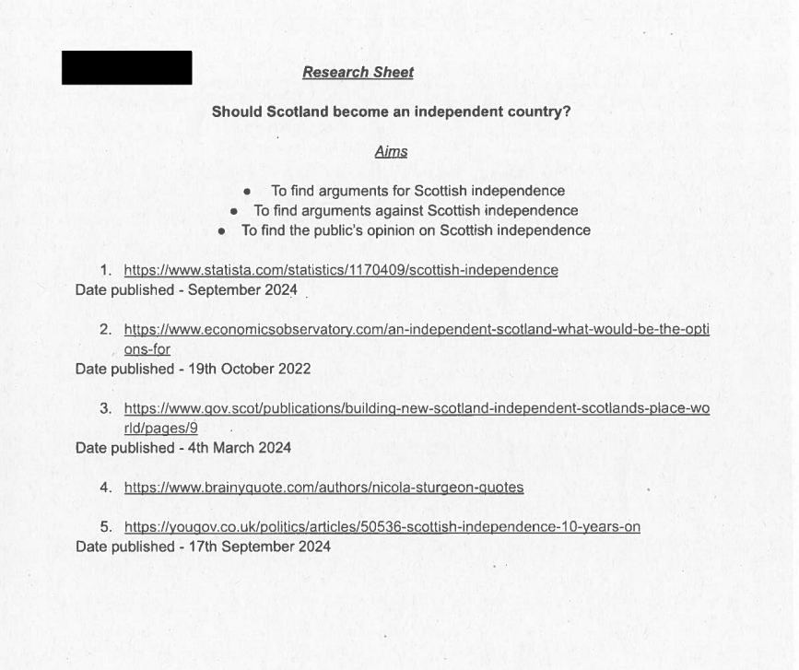
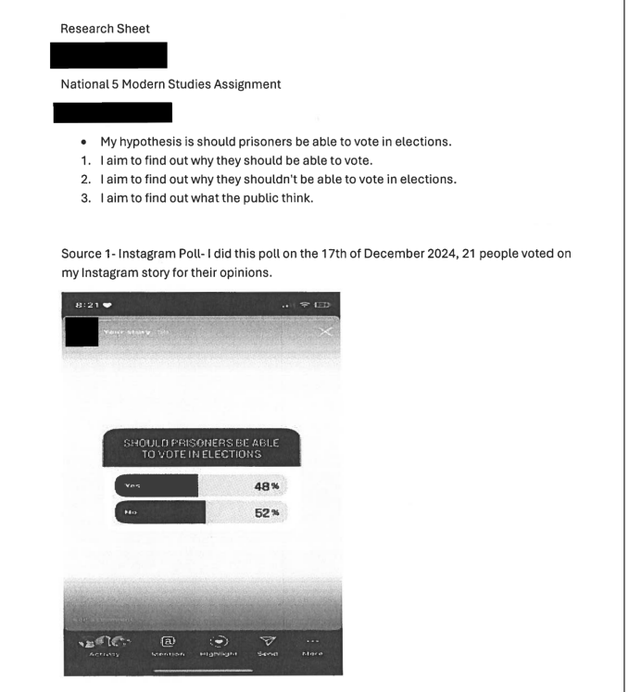
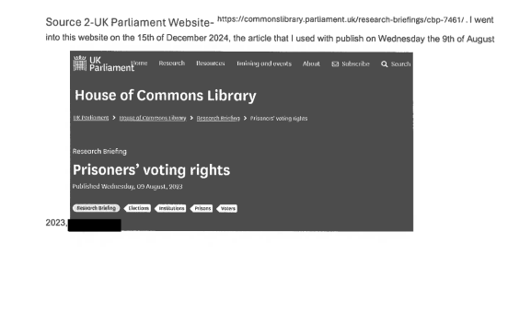
Examples of Research Sheets

Slide 18

Research Methods
Students are expected to evaluate their research methods and the sources of information that they have used.
This forms a significant part of the N5 write up. This section is worth 10 marks. Students have been advised to consider:
X2 Strengths of their research method and why
X2 Weaknesses of their research methods and why
If you were to conduct this research again, what would you do differently

Slide 19
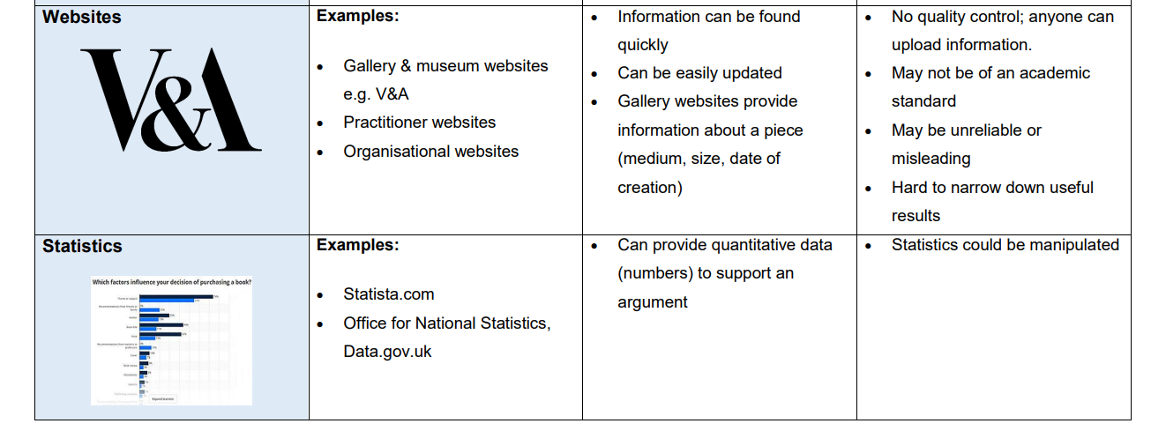
Research Methods
We will spend some (limited) time in class looking at different types of research methods.
I would encourage learners to complete at least one Primary research method (survey/interview etc.) and one Secondary (podcast, news article, Government website etc.
Strengths
Weaknesses

Slide 20
Research Methods
Strengths
Weaknesses
If there are three aims, then I would expect learners to have at least three sources.
However, only two sources need to be analysed (strengths and weaknesses) within the final write up.

Slide 21
Marking of the Higher Assignment
Identifying and demonstrating knowledge and understanding of the issue about which a decision has to be made, including alternative courses of action (10 marks for KU)
Analysing and synthesising information from a range of sources including use of specified resources (10 analysis marks)
Evaluating the usefulness and reliability of a range of sources of information (2 marks)
Communicating information using the conventions of a report (4 marks)
Reaching a decision, supported by evidence, about the issue (4 marks)

Slide 22
Marking of the N5 Assignment (20 marks available)
Evaluating the effectiveness of two research methods
Commenting on their strengths and weaknesses where appropriate.
Candidate should avoid simply giving generic descriptions of research methods, rather than making specific reference to their actual methods used, shown on their research sheet. (10 marks)

Slide 23
Marking of the N5 Assignment (20 marks available)
Presenting their Findings
Drawing on knowledge and understanding to explain and analyse key features of the topic or issue. (making connections, identifying trends, implications, consequences etc.)
Candidates must make at least one direct reference to the research evidence brought into the assessment. (6 marks)

Slide 24
Marking of the N5 Assignment (20 marks available)
Reaching a well-supported conclusion
Supported by evidence, about the topic or issue Candidates may gain credit in a number of ways up to a maximum of 4 marks.
Candidates should demonstrate modern studies skills of making decisions, recommendations, or reaching conclusions based upon evidence they have provided. Do not award marks for repetition of findings. (4 marks)

Slide 25
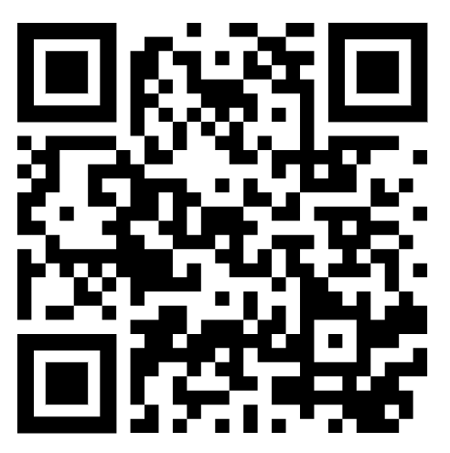
Understanding Standards
Please feel free to scan the QR code and use the Qualifications Scotland Understanding Standards Website. It has examples of real learners' assignments and commentaries from the SQA and where they have been awarded/not awarded marks.
I would highly encourage learners to look through this – it will also give you some clarity to how QS award marks.

Slide 26
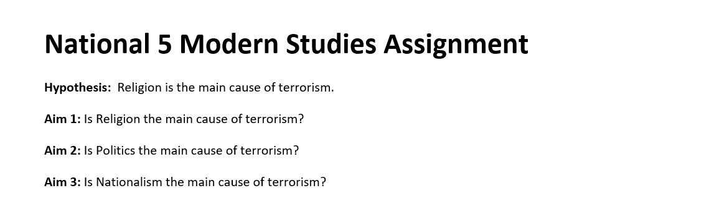
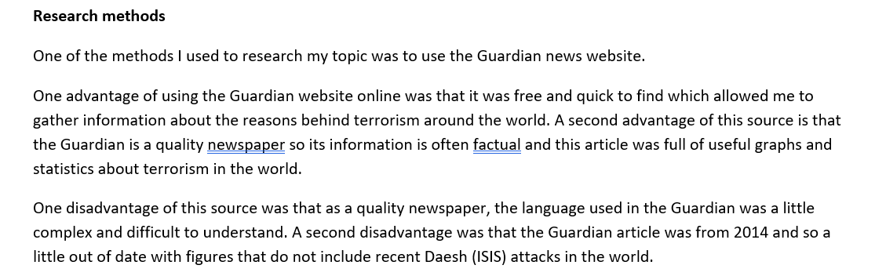
Example Assignment

Slide 27
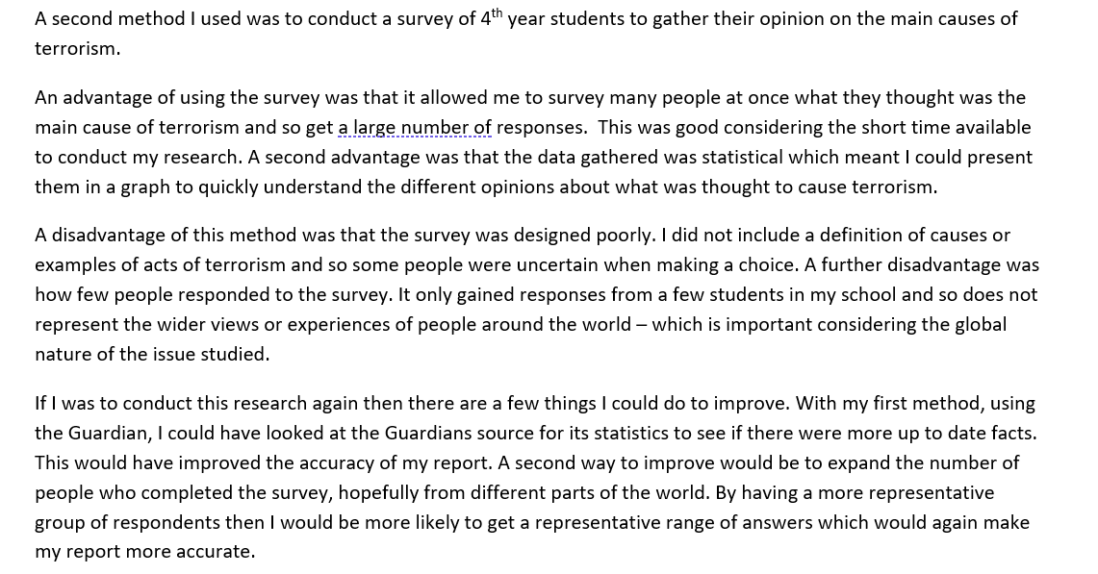
Example Assignment

Slide 28
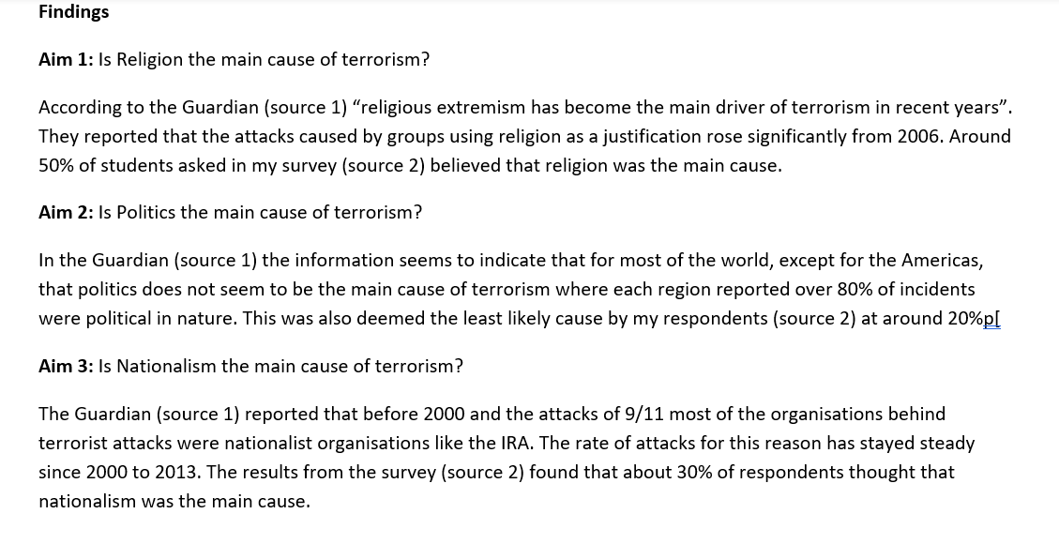
Example Assignment

Slide 29
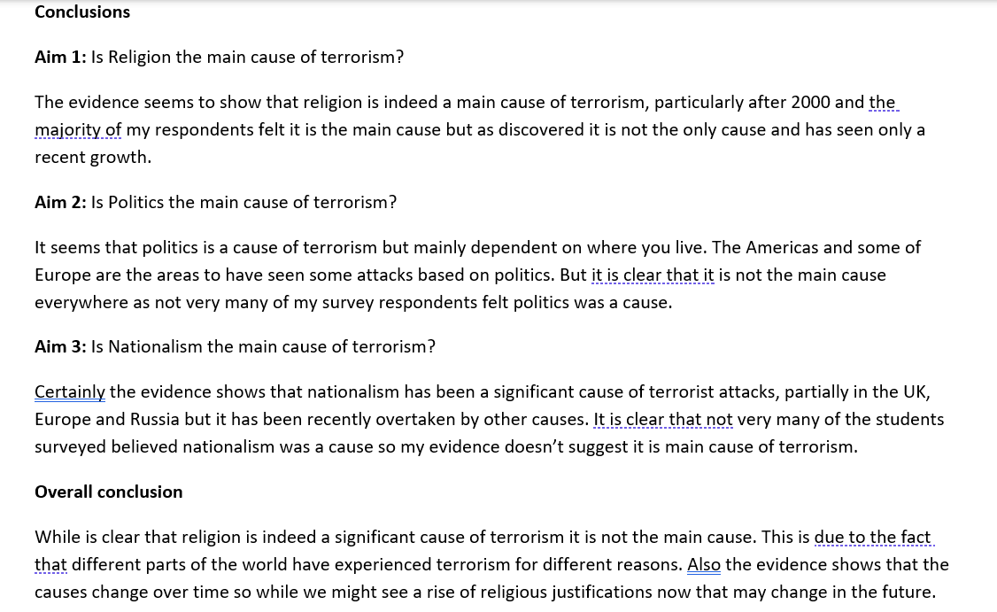
Example Assignment

Slide 30

Questions

