Slide 1
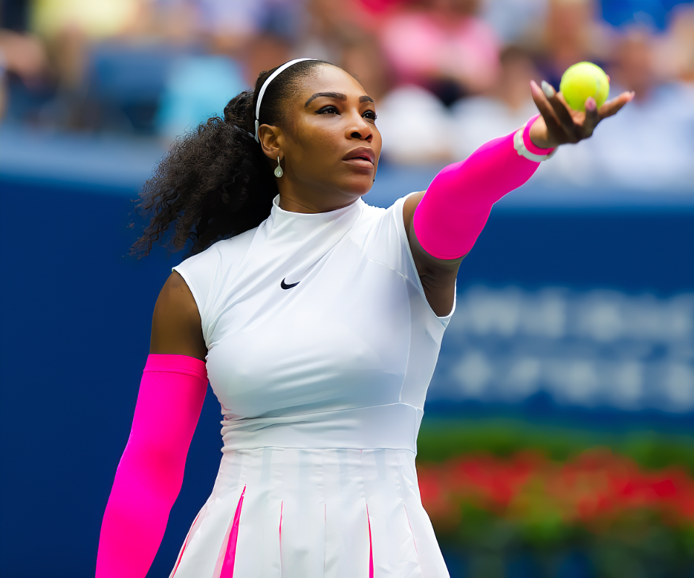
S1 PE Family Learning Task Term 2 Athlete Research Project
Elite athletes make for positive role models as they promote physical activity, demonstrate a good work ethic and motivation to succeed.
Family Learning Task:
Select and research an athlete or sports team that you and your parent/carer look up to as a sporting role model(s). Research and produce a factsheet including the following information for guidance:
Your athlete’s name and age/ when the team/club was founded;
Some details on their early life and history;
Details of their sporting career/ historical sporting moments;
Main highlights/achievements in their career so far;
What the future holds for your chosen role model/ team/ club;
Why they inspire you and your parent/carer.
Present your work on a format of your choice: handwritten/typed on A4 piece of paper, a power point or record a podcast or video.

