Slide 1
10 Minute Revision
Week 2

Slide 2
3 Steps to Studying:
Step 1
Revise the content:
Mind Map
Flash Cards (make)
Key words
Reduce your notes
Cornell Notes
Revision Poster
Post-its
Dual coding
Revision Clock
Step 2
Retrieval Practice (check what you have learned):
Cops & Robbers
Retrieval Relay
Use Flash Card questions
10 questions
If this is the question – what is the answer?
Step 3
Past Paper Questions:
Now do a question on the topic that you have studied
Build in timed questions (1.75 minutes per mark)
Hand in for feedback

Slide 3
Flash Cards
Period 1: Revise the Content
Flash cards are a classic revision tool
Make your own – question on one side and answer on the other
Keep your cards once you make them and use them to question yourself – they promote active recall

Slide 4
How is a meander formed? (1)
River flows downhill causing lateral erosion.
Doesn’t flow in a straight line -contains areas of deep water and areas of shallow water
Means slower and faster water movement
This causes the current to swing from side to side - meandering.

Slide 5
Your Turn!
How is a meander formed? (1)
You have a set of revision notes on processes of erosion and the formation of a meander
Start a set of flash cards on how a meander is formed – make one card for each stage
Shorten the notes & add a diagram (if space!)
How is a meander formed? (2)
How is a meander formed? (3)

Slide 6
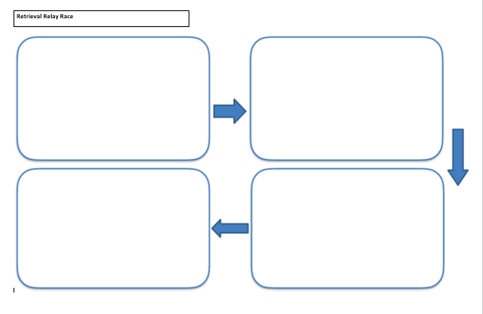
Period 2: Retrieval Practice
Retrieval Relay Race
Without your notes, write as much as you can remember about the formation of a meander in the first box (1 minute)
Now check your flash cards(1 minute)
Put your notes away and write anything you missed in box 2 (1 minute)
And repeat…

Slide 7
Period 3 – Exam Question
Explain the formation of a meander (4)

