Slide 1
10 Minute Revision
Week 1

Slide 2
3 Steps to Studying:
Step 1
Revise the content:
Mind Map
Flash Cards (make)
Key words
Reduce your notes
Cornell Notes
Revision Poster
Post-its
Dual coding
Revision Clock
Step 2
Retrieval Practice (check what you have learned):
Cops & Robbers
Retrieval Relay
Use Flash Card questions
10 questions
If this is the question – what is the answer?
Step 3
Past Paper Questions:
Now do a question on the topic that you have studied
Build in timed questions

Slide 3
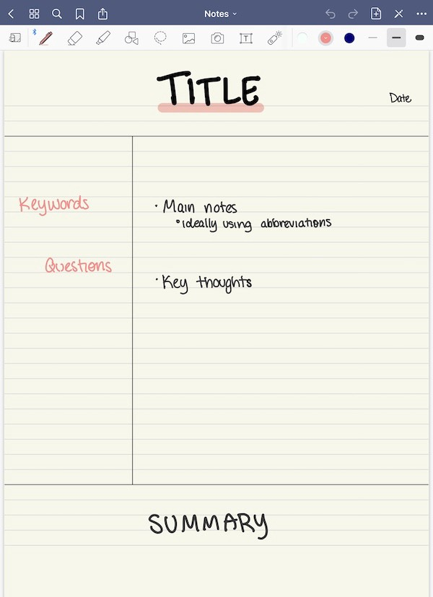
Cornell Notes
Period 1: Revise the Content
Cornell Notes are a way of taking notes.
We are going to use them as a revision technique.
They are an efficient and easy way of organising your class notes, and might be useful for people who find mind maps confusing!

Slide 4
Key words and questions go here.
You could put a question that you might be asked in the exam.
The title of this part of the unit (e.g. Areas of low population density)
Your main notes:
Bullet point, shorten, key words, diagrams and pictures
This part comes later (24 hours) – hide the top part, can you summarise it?

Slide 5
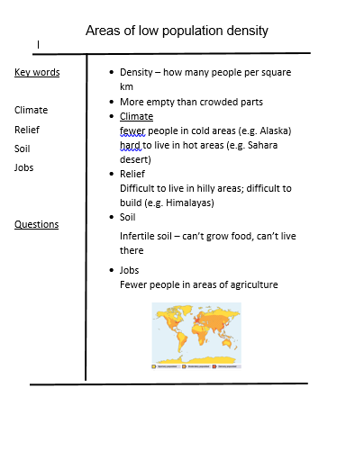

Slide 6
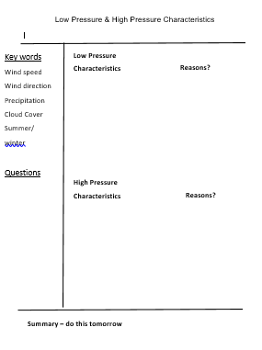
Your Turn!
You have a set of revision notes on high and low pressure weather
Create a Cornell Note for characteristics and reasons for them
Spend 10-15 minutes on this (make a different Cornell note for each sub-topic)

Slide 7
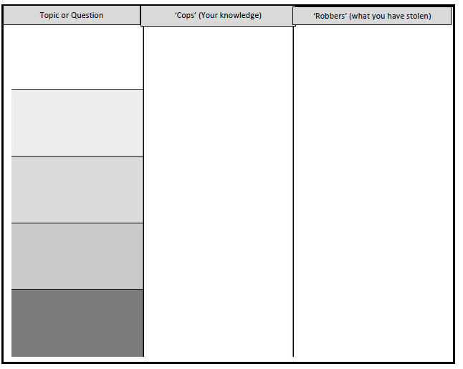
Period 2: Retrieval Practice
Cops & Robbers
Without your notes, write as much as you can remember about the characteristics of high and low pressure weather systems in the ‘Cops’ column (5 minutes)
Now check your notes – write anything you missed in the ‘Robbers’ column (5 minutes). This is what you need to spend more time learning!

Slide 8
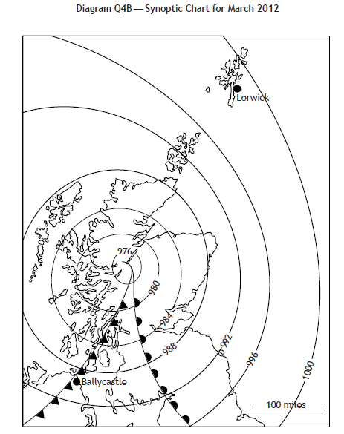
Period 3 – Exam Question

