Slide 1
HWB Committee
Random Act of Kindness Day 17th February 2022
What can you do to make someone’s day?

Slide 2
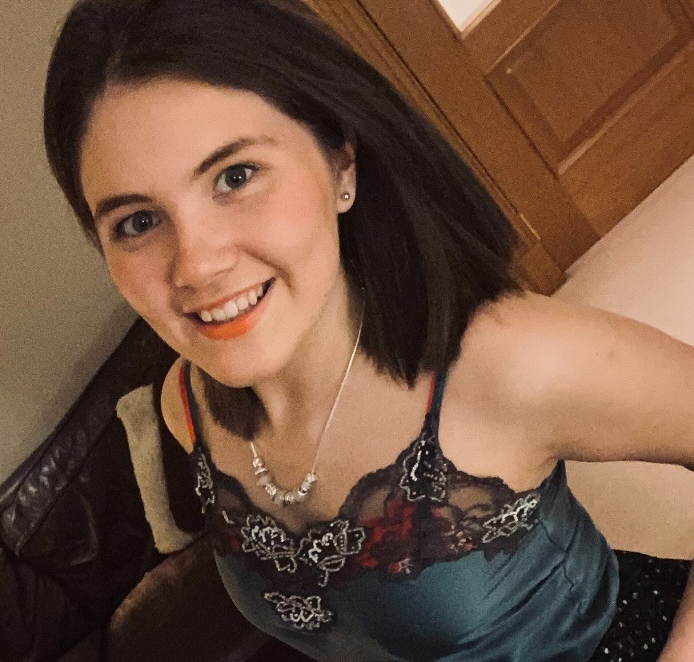
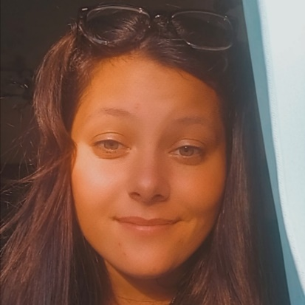
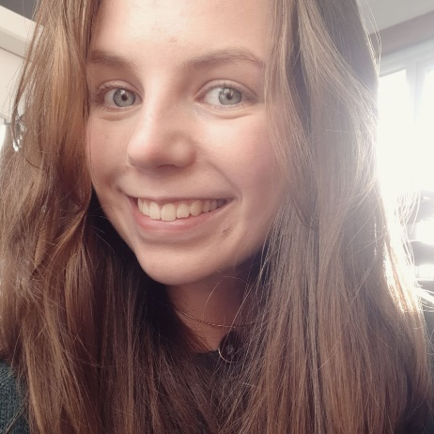
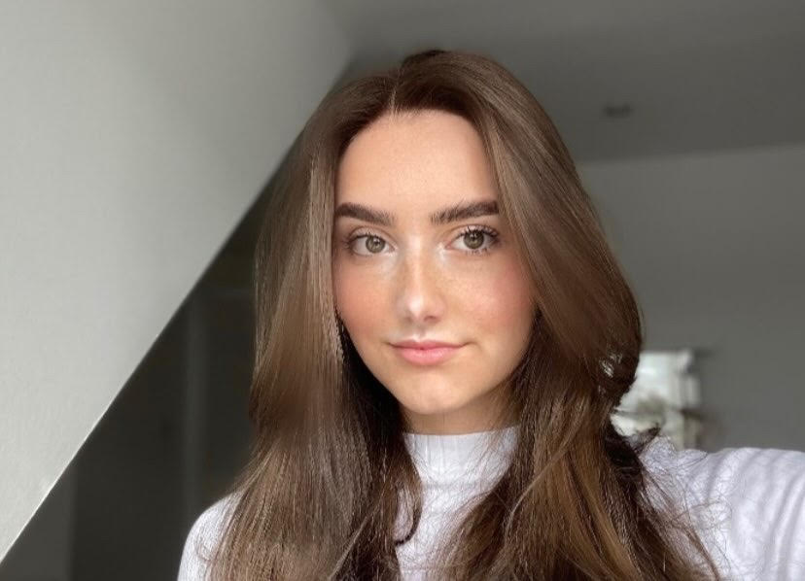
Inspiration For Random Acts Of Kindness
Our Ideas!
Julia – Make time to meet up with a friend
Sophie – Hold the door open for stranger
Josh – Make a playlist for a friend
Bronwyn – Make whoever is at home a hot drink
Iona – Compliment someone’s nature
Hannah – Ask how someone’s day has been

Slide 3
Remember – There is always support!
It is important to remember someone is always here to help and support you as well as help to signpost onto other supports if needed:
HWB Champs – Talk to US!
Pupil Support Staff – in fact, any member of staff
Mental Health First Aiders – Staff wearing a purple lanyard
Saskia, School Counsellor - in school Wednesday, Thursday & Friday. You can arrange to see her through your Pupil Support Teacher, a drop in slip (across the corridor from the wellbeing office), or by emailing: linlithgowsupport@yourspace-scotland.com

