Slide 1
Children's Mental Health Week
2022

Slide 2
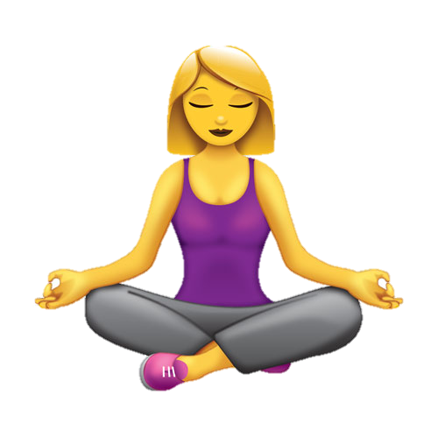
Mindfulness Monday (Sophie)
Mindfulness is all about being aware of something.
Find a comfortable and quiet space
Sit down with your eyes closed
Set a timer
Take deep breaths and focus alertly on them
If any other thoughts come into your mind, note them but return your focus to your breath
Be proud for taking some worthwhile time to yourself! :)

