Slide 1
Higher RMPS REVISION TASKS
Use this resource to help with your revision.

Slide 2
Task 1- Life of Buddha
1. Create a timeline of all the key moments in the Buddha’s life.
Use colour, symbols and images.
2. Try to narrow the key moments down to 6 key points. Choose the 6 most important points.
3. Answer this question.
Describe the Life of the Buddha. (6 Marks)

Slide 3
Task 2 - The Buddha’s Beliefs
Describe what the main beliefs of the Buddha were. (6 Marks)
Use this source to help you.
https://www.bbc.co.uk/education/clips/zb37tfr

Slide 4
Task 2 (b) - The Buddha’s Beliefs (can you form links between these main Buddhist beliefs – these links can form between any of the beliefs)
Dukkha
4 Noble Truths
Kamma
Samsara
Nibbana
Anicca
Anatta
3 Root Poisons

Slide 5
Task 3 - The importance of the Buddha.
Explain why the Buddha is important to Buddhists. (4 marks)

Slide 6
Task 4 - Buddhism Glossary
Create yourself an Buddhism glossary that you can use for reference on words you come across in Pali that you need to remember.
Use colour and images to help you.
Get someone to test you on these words and their meanings.

Slide 7
Task 5 - Samsara
Explain what is meant by Samsara (4 marks)
Describe the Buddhist wheel of life.
What are the benefits and difficulties to Buddhists of believing in samsara.

Slide 8
Task 6- Kamma
Give 3 examples of skillful actions
Give 3 examples of unskillful actions
Explain the importance of Kamma (4 Marks)

Slide 9
Task 7- Worship
Describe how Buddhists show their commitment to Buddhism. (6 Marks)
How might Theravadin worship differ to that of a follower of Mahayana buddhism.

Slide 10
Task 8- 3 Marks of Existence
Write the name of one of the Three Marks of Existence in each circle. Under each name describe what it means and how the three are linked together.

Slide 11
Task 9- Nature of Humans
Draw a human outline.
Inside it write everything Buddhist’s believe about the nature of human beings.

Slide 12
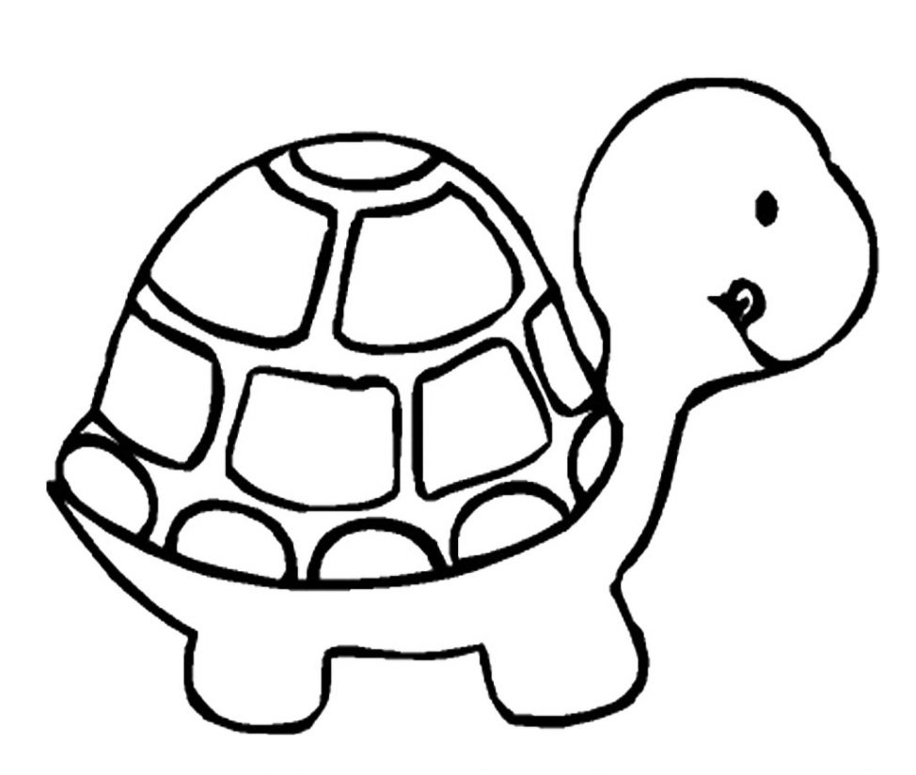
Task 10 - Nibbana
Draw a fish and a turtle – link these animals to the idea
of nibbana
Explain is meant by Nibbana.
Describe the Theravadin belief in the Arhat
Describe the Mahayanin belief in the Bodhisattva

Slide 13
Task 11-Impermanence
Explain Buddhist beliefs about Impermanence. (6 Marks)
Give examples to support your answer.

Slide 14
Task 12- Meditation
Describe two forms of Buddhist meditation. (4 Marks)
Explain why meditation is an important aspect of Buddhist practice. (6 marks)

Slide 15
Task 13- Theravada & Mahayana Buddhism
In each of the large circles write the differences between Theravada and Mahayana Buddhism, with the similarities in the middle section.
Theravada Buddhism
Mahayana Buddhism
Both

Slide 16
Task 14- The three jewels
Describe The 3 Jewels in Buddhism
Explain why each of these are important to Buddhists

Slide 17
Task 15 – Samsara and nibbana
Nibbana
Life
Death
Death
Death
Life
Life
Write a detailed explanation about what this diagram shows about Buddhist beliefs. Your explanation should also include the beliefs of Theravada and Mahayana Buddhists.

Slide 18
Task 16- 10 Precepts
10 Precepts
Followed by all Buddhists
Followed by Monks and Nuns
Create a mind map of the 10 precepts.
Describe each of the 10 precepts
Importance of them in Buddhism
Difficulties in following them

Slide 19
Task 17 – Sangha
Explain what Buddhist understand by the term Sangha
“Living as part of the sangha is no longer relevant in today’s world.”
Would Buddhists agree? (8 marks)
Answer:
https://www.sqa.org.uk/pastpapers/papers/instructions/2015/mi_N5_Religious-Moral-and-Philosophical-Studies_mi_2015.pdf

Slide 20
Task 18- Story of Kisagotami
Draw a cartoon to illustrate the story of Kisagotami – how does this story demonstrate the Three Marks of Existence.

Slide 21
Task 19- Tanah
Create an image to illustrate the idea of Tanah.
Why is this an important in the teachings of the Buddha.

Slide 22
Task 20-Three Root Poisons
Describe the 3 Root Poisons in Buddhism and give an example of each.
Why are the Three Root Poisons referred to as the “fuel of the wheel”

Slide 23
Task 21- The Noble Eightfold Path
Create a revision guide for yourself that explains the Noble Eightfold Path, specifically concentrating on Right Intention, Right Speech, Right Livelihood, Right Action.
Why is the path important, what is involved in following each of guidelines and any difficulties that could be faced when putting them into practice.

Slide 24
Task 22- How was the world created?
Create a comic strip outlining the main events of Genesis 1 and Genesis 2.

Slide 25
Task 23- Literal Christians
Outline the main ideas of Literal Christians on the origins of the world.
What arguments would others just to criticise these views.

Slide 26
Task 24 –Liberal Christian Viewpoint
Outline the main ideas of Liberal Christians on the origins of the world.
What arguments would others just to criticise these views.

Slide 27
Task 25 – Cosmological Argument
Create a diagram to illustrate the Cosmological (First Cause) Argument
Outline two arguments used to support and two arguments used to oppose this view

Slide 28
Task 26- Big Bang
Explain how the world was created by the big bang.
Include the following key words:
* Nothing before
* Singularity
* Explosion
*13.7 billion years ago
* Space, Time, Energy and matter

Slide 29
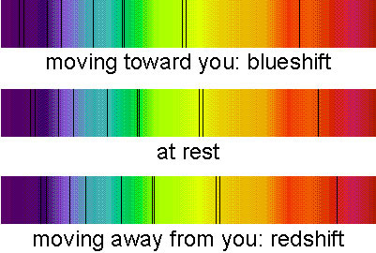
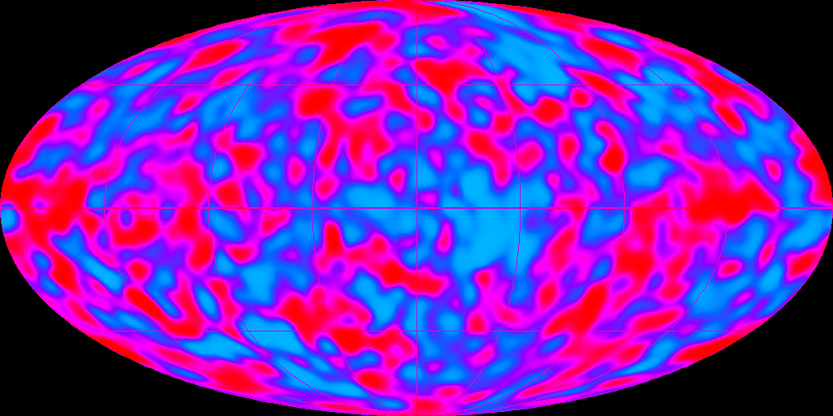
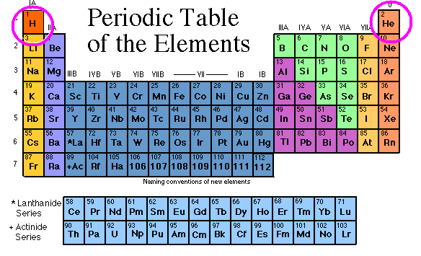
Task 27- Evidence for the Big Bang
Evidence | How does this support the Big Bang Theory
Red Shift
Cosmic Background Radiation
Abundance of Elements

Slide 30
Task 28-How was the world created?
Describe a religious response to this question (4 marks)
Describe Sciences’ response to this question. (4 Marks)
Explain how the two viewpoints are similar or different (3 marks)

Slide 31
Task 29- Evolution
Explain the process of evolution.
Include the following key terms:
* Natural Selection
* Survival of the Fittest

Slide 32
Task 30- Evidence for Evolution
Hide and Seek cards – copy the table onto A4 paper
Evidence for Evolution | How it supports Evolution
Darwin’s discoveries in the Galapagos - Finches | Answer: | Fold over to hide the answer
Discovery of DNA |  | Fold over to hide the answer
Fossil Records |  | Fold over to hide the answer
Biodiversity |  | Fold over to hide the answer
Common Features |  | Fold over to hide the answer

Slide 33
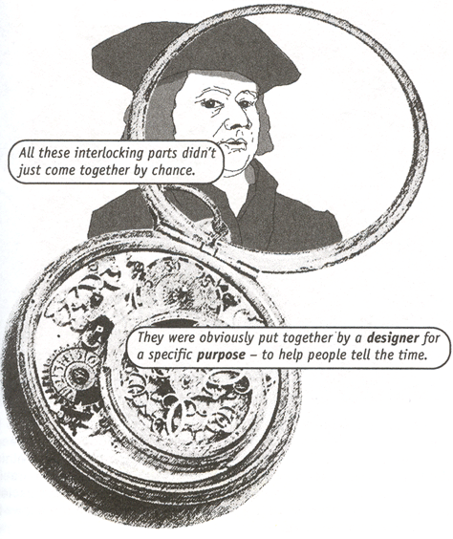
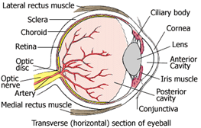
Task 31 – Teleological Argument
Use the following images to explain the Teleological (Design)
Argument.
Give two reasons to support this argument and two reasons
To oppose the argument.

Slide 34
Task 32 - Viewpoints for Evolution
Science
Literal Christians
Liberal Christians

Slide 35
Task 33 - On One Hand…
“The theory of evolution is enough to prove that life does not require a creator? Discuss
Use the below structure to help you structure your answer.
Point 1
Point 2
Point 2
Point 1
Point 3
Point 3
Point 4
Science would respond to this question…
Point 4
Christians would respond to this question by saying…
On the other Hand…
On One Hand…
THEREFORE…

